Slide 1
Debt Ceiling Debate
November 2013
FIN310 JU Class

Slide 2
What is Debt Ceiling
When the federal government spends more than it takes in taxes, U.S. Treasury has to borrow the rest to pay all its bills.
But Congress imposed a legal limit on how much money the Treasury can a borrow from outsiders and other government accounts ----- debt ceiling
The current debt limit is $16.699 trillion
The debt ceiling determines whether the U.S. government can borrow enough money to pay for enacted programs
Medicare reimbursements
or military pay.

Slide 3
When will hit debt ceiling
The U.S. government hit its $16.699 trillion borrowing limit on May 19 and have ensured the payment obligations, like paying bondholders and sending out Social Security checks.
By Oct. 17, the Treasury Department will be running low on cash, and it won't be able to borrow.
At Oct. 17, Treasury would have $30 billion to meet our country's commitments, far short of net expenditures as high as $60 billion.

Slide 4
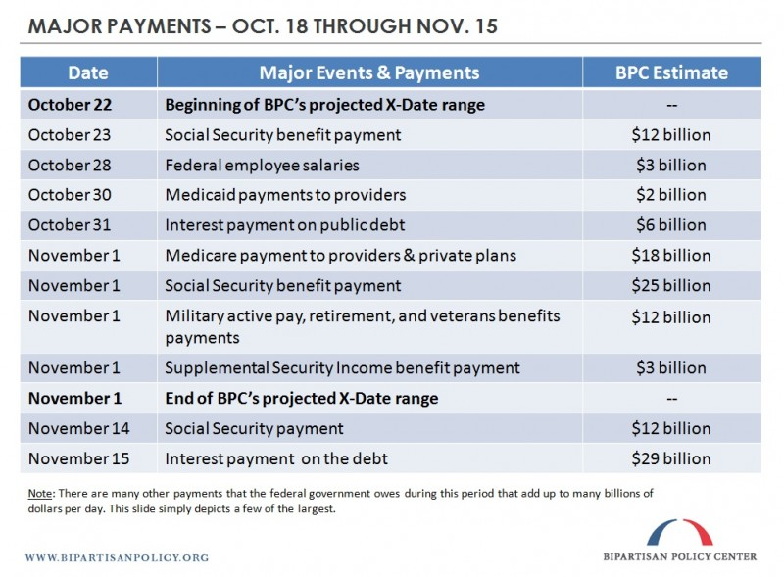

Slide 5
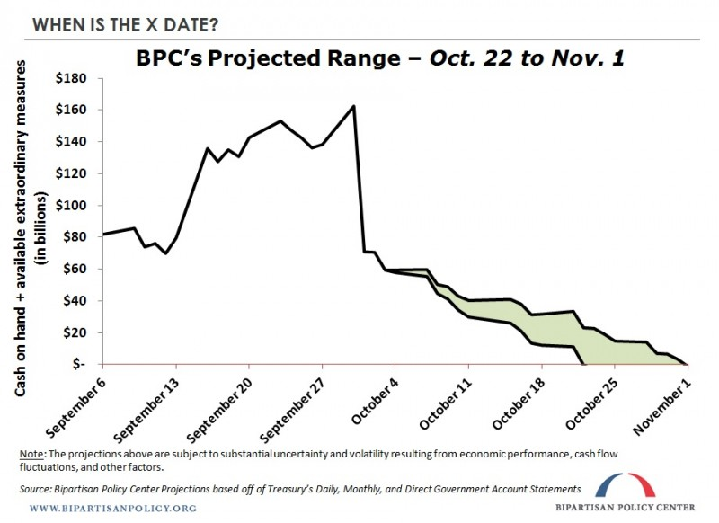

Slide 6
What if the government cannot pay
US government checks started bouncing.
IOU to a defense contractor
A retiree SS Check delayed
Most important, turmoil in the financial market.
U.S. Treasuries are the safest asset in the world.
If that assumption were ever called into question, havoc could ensue.

Slide 7
Economic consequences of crashing into the debt ceiling?
A default on the debt would create big disruptions in the financial markets.
Credit markets could freeze
the value of the dollar could plummet
U.S. interest rates could skyrocket
the negative spillovers could reverberate around the world,
the U.S. stock market fall about 45%

Slide 8
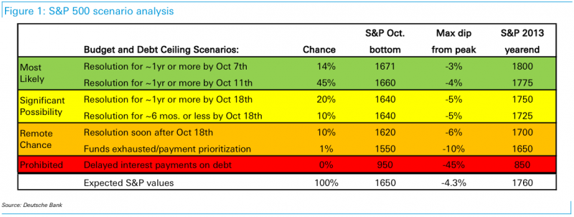
Estimation of Impact in S&P

Slide 9
Can Obama administration do something to avoid it?
The Obama administration has ruled them all out.
First, Treasury could try to buy time by delaying payments , but it is unsustainable.
Simply ignoring the debt ceiling?
Obama ignore the debt ceiling and issue new bonds?
legally questionable
lenders might be wary of buying new U.S. government debt
creating more market panic.

Slide 10
New Level of Debt Ceiling
Congress need to raise the debt ceiling by $1.1 trillion to allow the government to meet all of its obligations through the end of 2014.

Slide 11
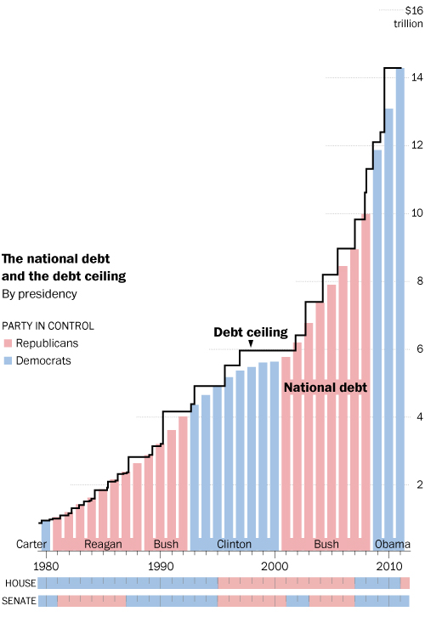

Slide 12
Shall We Abolish Debt Ceiling?
Debt ceiling was first adopted in 1917 to prevent the president from spending however much he wanted.
Since 1974, Congress has created a formal budget process to control spending levels. So no need for Congress to authorize borrowing for spending that Congress has already approved
So many scholars support for abolishing debt ceiling

Slide 13
Debt Ceiling Global Impact I
If the debt ceiling is not increased, will see the economic fallout
increased interest rates
slower global economic growth
falling business confidence.
a "disastrous impact" on poor nations.
would be harmful to the entire world

Slide 14
Debt Ceiling Global Impact II
Emerging and developing countries that issue dollar-denominated bonds could pay a higher price should the U.S. default.
U.S. Treasuries is safe and the most liquid assets, so it is a cornerstone of global financial markets.
U.S. Treasuries because of their high rating constitute the largest share of central banks’ international reserves.
dollar securities amount to $3.8 trillion or 62 percent of central banks’ reported international reserves
$1.4trillion or 24 percent of total for euro-denominated instruments.

Slide 15
Debt Ceiling Global Impact III
In spite of calls to reduce the dependence on U.S. Treasuries, diversifying international reserves away from U.S. dollar assets will be a slow moving process
Because few alternatives available
China and Japan still hold $1.3 and $1.1 trillion in U.S. Treasuries respectively

Slide 16
Chinese Government’s Attitude I
Few creditors doubt the U.S.’s capacity to pay its debt, but the political theater surrounding the debt ceiling has clouded market perceptions about the U.S.’s willingness to pay its debt.
China, Brazil, Japan, Singapore, and others invest in dollars
Not for profitable
but for safe, liquid assets.
This helps explain why foreign governments hold 2/5 of the $11.6 trillion U.S. debt.

Slide 17
Chinese Government’s Attitude II
Over the last two years, foreign governments are skeptical about the U.S.’s fiscal governance.
During the first debt ceiling showdown in 2011, China expressed its “hope that the U.S. government adopts responsible and measures to guarantee the interests of investors.”
More recently, China’s state newspaper, Xinhua, said that it was time to “start considering building a de-Americanized world” that would include the “introduction of a new international reserve currency.” And notwithstanding the budget deal, China’s largest credit rating agency, Dagong Global, downgraded U.S. debt.

Slide 18
Chinese Government’s Attitude III
To mitigate this growing global scrutiny and rising interest rate premium, the U.S. should scrap its debt ceiling.
It serves such little economic purpose
It has been used as a political tool, allowing the opposition party to signal its discontent with deficit spending.
The debt ceiling undermines the U.S.’s credible commitment to pay its debt.
It imposes a short-term financing calendar
creditors wondering every few months about the U.S.’s fiscal resolve.
Endowing the U.S. Treasury with automatic authority to fund congressionally approved spending will help mitigate uncertainty.

