Slide 1

Chapter 13
Return, Risk, and the Security Market Line
McGraw-Hill/Irwin
Copyright © 2013 by The McGraw-Hill Companies, Inc. All rights reserved.
Notes:
Notes to the Instructor:
The PowerPoints are designed for an introductory finance class for undergraduates with the emphasis on the key points of each chapter
Each chapter’s PowerPoint is designed for active learning by the students in your classroom
Not everything in the book’s chapter is necessarily duplicated on the PowerPoint slides
There are two finance calculators used (when relevant). You can delete the slides if you don’t use both TI and HP business calculators
Animation is used extensively. You can speed up, slow down or eliminate the animation at your discretion. To do so just open a chapter PowerPoint and go to any slide you want to modify; click on “Animations” on the top of your PowerPoint screen tools; then click on “Custom Animations”. A set of options will appear on the right of your screen. You can “change” or “remove” any line of that particular slide using the icon on the top of the page. The speed is one of the three options on every animation under “timing”.
Effort has been made to maintain the basic “7x7” rule of good PowerPoint presentations.
Additional problems and/or examples are available on McGraw-Hill’s Connect.

Slide 2
Chapter Outline
Expected Returns and Variances
Portfolios
Announcements, Surprises, and Expected Returns
Risk: Systematic and Unsystematic
Diversification and Portfolio Risk
Systematic Risk and Beta
The Security Market Line
The SML and the Cost of Capital: A Preview

Slide 3
Expected Returns
Expected returns are based on the probabilities of possible outcomes
In this context, “expected” means average if the process is repeated many times
The “expected” return does not even have to be a possible return
Notes:
Lecture Tip: You may find it useful to emphasize the economic foundations of the material in this chapter. Specifically, we assume:
-Investor rationality: Investors are assumed to prefer more money to less and less risk to more, all else equal. The result of this assumption is that the ex ante risk-return trade-off will be upward sloping.
-As risk-averse return-seekers, investors will take actions consistent with the rationality assumptions. They will require higher returns to invest in riskier assets and are willing to accept lower returns on less risky assets.
-Similarly, they will seek to reduce risk while attaining the desired level of return, or increase return without exceeding the maximum acceptable level of risk.

Slide 4
Example: Expected Returns
Suppose you have predicted the following returns for stocks C and T in three possible states of the economy.
1. What is the probability of “Recession”?
  State Probability C T
  Boom 0.3 15 25
  Normal 0.5 10 20
  Recession ??? 2 1
  Probabilities add up to 100% (or 1.0) thus 1.0 – 0.3 – 0.5 = 0.2 or 20%

Slide 5
Example: Expected Returns
Suppose you have predicted the following returns for stocks C and T in three possible states of the economy.
2. What are the expected returns?
  State Probability C T
  Boom 0.3 15 25
  Normal 0.5 10 20
  Recession 0.2 2 1
R_{C} = .3(15) + .5(10) + .2(2) = 9.9%
R_{T} = .3(25) + .5(20) + .2(1) = 17.7%

Slide 6
Variance and Standard Deviation
Variance and standard deviation measure the volatility of returns
Using unequal probabilities for the entire range of possible outcomes
Weighted average of squared deviations
Notes:
It’s important to point out that these formulas are for populations, unlike the formulas in chapter 12 that were for samples (dividing by n-1 instead of n). Further, the probabilities that are used account for the division.
Remind the students that standard deviation is the square root of the variance.

Slide 7
Example: Variance and Standard Deviation
Considering the previous example of stocks C and T:
  State Probability C T
  Boom 0.3 15 25
  Normal 0.5 10 20
  Recession 0.2 2 1
  Expected return 9.9% 17.7%

Slide 8
Example: Variance and Standard Deviation
1. What is the variance and standard deviation for C?
  State Probability C T
  Boom 0.3 15 25
  Normal 0.5 10 20
  Recession 0.2 2 1
  Expected return 9.9% 17.7%
Stock C
  σ² = .3(15-9.9)² + .5(10-9.9)² + .2(2-9.9)² = 20.29
  σ = 4.50%

Slide 9
Example: Variance and Standard Deviation
2. What is the variance and standard deviation for T?
  State Probability C T
  Boom 0.3 15 25
  Normal 0.5 10 20
  Recession 0.2 2 1
  Expected return 9.9% 17.7%
Stock T
  σ² = .3(25-17.7)² + .5(20-17.7)² + .2(1-17.7)² = 74.41
  σ = 8.63%
Notes:
It is helpful to remind students that the standard deviation (but not the variance) is expressed in the same units as the original data, which is a percentage return in our example.

Slide 10
Another Example
Consider the following information:
  State Probability ABC, Inc. (%)
  Boom .25 15
  Normal .50 8
  Slowdown .15 4
  Recession .10 - 3
1. What is the expected return?
E(R) = .25(15) + .5(8) + .15(4) + .1(-3)
= 8.05%

Slide 11
Another Example
Consider the following information:
  State Probability ABC, Inc. (%)
  Boom .25 15
  Normal .50 8
  Slowdown .15 4
  Recession .10 - 3
2. What is the variance?
Variance = σ²= .25(15-8.05)² + .5(8-8.05)² + .15(4-8.05)² + .1(-3-8.05)²
= 26.7475

Slide 12
Another Example
Consider the following information:
  State Probability ABC, Inc. (%)
  Boom .25 15
  Normal .50 8
  Slowdown .15 4
  Recession .10 - 3
3. What is the standard deviation?
Standard Deviation = σ = √ 26.7475
= 5.17%

Slide 13

Portfolios
A portfolio is a collection of assets
An asset’s risk and return are important in how they affect the risk and return of the portfolio
Notes:
Lecture Tip: Each individual has their own level of risk tolerance. Some people are just naturally more inclined to take risk, and they will not require the same level of compensation as others for doing so. Our risk preferences also change through time. We may be willing to take more risk when we are young and without a spouse or kids. But, once we start a family, our risk tolerance may drop.

Slide 14

Portfolios
The risk/return trade-off for a portfolio is measured by the portfolio’s expected return and standard deviation, just as with individual assets
Risk
Return
Notes:
Lecture Tip: Each individual has their own level of risk tolerance. Some people are just naturally more inclined to take risk, and they will not require the same level of compensation as others for doing so. Our risk preferences also change through time. We may be willing to take more risk when we are young and without a spouse or kids. But, once we start a family, our risk tolerance may drop.

Slide 15
Example: Portfolio Weights
Suppose you have $15,000 to invest and you have purchased securities in the following amounts:
  $2000 of DCLK
  $3000 of KO
  $4000 of INTC
  $6000 of KEI
Notes:
DCLK – Doubleclick
KO – Coca-Cola
INTC – Intel
KEI – Keithley Instruments
Show the students that the sum of the weights = 1

Slide 16
Example: Portfolio Weights
What are your portfolio weights in each security?
  $2,000 of DCLK
  $3,000 of KO
  $4,000 of INTC
  $6,000 of KEI
  $15,000
DCLK: 2/15 = .133
KO: 3/15 = .200
INTC: 4/15 = .267
KEI: 6/15 = .400
15/15 = 1.000
Notes:
DCLK – Doubleclick
KO – Coca-Cola
INTC – Intel
KEI – Keithley Instruments
Show the students that the sum of the weights = 1

Slide 17
Portfolio Expected Returns
The expected return of a portfolio is the weighted average of the expected returns of the respective assets in the portfolio
You can also find the expected return by finding the portfolio return in each possible state and computing the expected value as we did with individual securities

Slide 18
Example: Expected Portfolio Returns
Consider the portfolio weights computed previously. The individual stocks have the following expected returns:
  DCLK: 19.69%
  KO: 5.25%
  INTC: 16.65%
  KEI: 18.24%

Slide 19
Example: Expected Portfolio Returns
1. What is the expected return on this portfolio?
  Return Weight
  DCLK: 19.69% .133
  KO: 5.25% .200
  INTC: 16.65% .267
  KEI: 18.24% .400
E(R_{P}) = .133(19.69) + .2(5.25) + .267(16.65) + .4(18.24)
= 15.41%

Slide 20
Portfolio Variance
Compute the expected portfolio return, the variance, and the standard deviation using the same formula as for an individual asset
Compute the portfolio return for each state:
R_{P} = w₁R₁ + w₂R₂ + … + w_{m}R_{m}
Notes:
A Lecture Tip in the IM also provides information on how to compute the portfolio variance using the correlation or covariance between assets, which is helpful to deepen students’ understanding of the impact of relative asset movement.

Slide 21
Example: Portfolio Variance
Consider the following information:
  State Probability A B
  Boom .4 30% -5%
  Bust .6 -10% 25%

Slide 22
Example: Portfolio Variance
Consider the following information:
  State Probability A B
  Boom .4 30% -5%
  Bust .6 -10% 25%
  1. What is the expected return for asset A?
Asset A: E(R_{A}) = .4(30) + .6(-10) = 6%

Slide 23
Example: Portfolio Variance
Consider the following information:
  State Probability A B
  Boom .4 30% -5%
  Bust .6 -10% 25%
  2. What is the variance for asset A?
Variance(A) = .4(30-6)² + .6(-10-6)²
= 384

Slide 24
Example: Portfolio Variance
Consider the following information:
  State Probability A B
  Boom .4 30% -5%
  Bust .6 -10% 25%
  3. What is the standard deviation for asset A?
Std. Dev.(A) = 19.6%

Slide 25
Example: Portfolio Variance
Consider the following information:
  State Probability A B
  Boom .4 30% -5%
  Bust .6 -10% 25%
  4. What is the expected return for asset B?
E(R_{B}) = .4(-5) + .6(25) = 13%

Slide 26
Example: Portfolio Variance
Consider the following information:
  State Probability A B
  Boom .4 30% -5%
  Bust .6 -10% 25%
  5. What is the variance for asset B?
Variance(B) = .4(-5-13)² + .6(25-13)²
= 216

Slide 27
Example: Portfolio Variance
Consider the following information:
  State Probability A B
  Boom .4 30% -5%
  Bust .6 -10% 25%
  6. What is the standard deviation for asset B?
Std. Dev.(B) = 14.7%

Slide 28
Example: Portfolio Variance
Consider the following information:
  State Probability A B
  Boom .4 30% -5%
  Bust .6 -10% 25%
  7. If you invest 50% of your money in Asset A, what is the expected return for the portfolio in each state of the economy?
If 50% of the investment is in Asset A, then 50% (100% - 50%) must be invested in Asset B as the total asset allocation must be 100%

Slide 29
Example: Portfolio Variance
Consider the following information:
  State Probability A B
  Boom .4 30% -5%
  Bust .6 -10% 25%
  8. If you invest 50% of your money in Asset A, what is the expected return for the portfolio in a boom period?
Portfolio return in boom = .5(30) + .5(-5)
= 12.5%

Slide 30
Example: Portfolio Variance
Consider the following information:
  State Probability A B
  Boom .4 30% -5%
  Bust .6 -10% 25%
  9. What is the expected return for the portfolio as a whole (considering both states of the economy)?
Exp. portfolio return = .4(12.5) + .6(7.5)
= 9.5%
Or Exp. portfolio return = .5(6) + .5(13)
= 9.5%

Slide 31
Example: Portfolio Variance
Consider the following information:
  State Probability A B
  Boom .4 30% -5%
  Bust .6 -10% 25%
  10. What is the variance of the portfolio?
Variance of portfolio =
.4(12.5-9.5)² + .6(7.5-9.5)²
= 6
Notes:
Note that the variance is NOT equal to .5(384) + .5(216) = 300 and
Standard deviation is NOT equal to .5(19.6) + .5(14.7) = 17.17%
What would the expected return and standard deviation for the portfolio be if we invested 3/7 of our money in A and 4/7 in B? Portfolio return = 10% and standard deviation = 0
Portfolio variance using covariances:
COV(A,B) = .4(30-6)(-5-13) + .6(-10-6)(25-13) = -288
Variance of portfolio = (.5)²(384) + (.5)²(216) + 2(.5)(.5)(-288) = 6
Standard deviation = 2.45%

Slide 32
Example: Portfolio Variance
Consider the following information:
  State Probability A B
  Boom .4 30% -5%
  Bust .6 -10% 25%
  11. What is the standard deviation of the portfolio?
Standard deviation = 2.45%
Notes:
Note that the variance is NOT equal to .5(384) + .5(216) = 300 and
Standard deviation is NOT equal to .5(19.6) + .5(14.7) = 17.17%
What would the expected return and standard deviation for the portfolio be if we invested 3/7 of our money in A and 4/7 in B? Portfolio return = 10% and standard deviation = 0
Portfolio variance using covariances:
COV(A,B) = .4(30-6)(-5-13) + .6(-10-6)(25-13) = -288
Variance of portfolio = (.5)²(384) + (.5)²(216) + 2(.5)(.5)(-288) = 6
Standard deviation = 2.45%

Slide 33
Another Example
Consider the following information:
  State Probability X Z
  Boom .25 15% 10%
  Normal .60 10% 9%
  Recession .15 5% 10%
What are the expected return and standard deviation for a portfolio with an investment of $6,000 in asset X and $4,000 in asset Z?
Notes:
Portfolio return in Boom: .6(15) + .4(10) = 13%
Portfolio return in Normal: .6(10) + .4(9) = 9.6%
Portfolio return in Recession: .6(5) + .4(10) = 7%
Expected return = .25(13) + .6(9.6) + .15(7) = 10.06%
Variance = .25(13-10.06)² + .6(9.6-10.06)² + .15(7-10.06)² = 3.6924
Standard deviation = 1.92%
Compare to return on X of 10.5% and standard deviation of 3.12%
And return on Z of 9.4% and standard deviation of .49%
Using covariances:
COV(X,Z) = .25(15-10.5)(10-9.4) + .6(10-10.5)(9-9.4) + .15(5-10.5)(10-9.4) = .3
Portfolio variance = (.6*3.12)² + (.4*.49)² + 2(.6)(.4)(.3) = 3.6868
Portfolio standard deviation = 1.92% (difference in variance due to rounding)
Lecture Tip: Here are a few tips to pass along to students suffering from “statistics overload”:
-The distribution is just the picture of all possible outcomes
-The mean return is the central point of the distribution
-The standard deviation is the average deviation from the mean
-Assuming investor rationality (two-parameter utility functions), the mean is a proxy for expected return and the standard deviation is a proxy for total risk.

Slide 34

Systematic Risk
Risk factors that affect a large number of assets
Also known as non-diversifiable risk or market risk
Includes such things as changes in GDP, inflation, interest rates, etc.

Slide 35

Unsystematic Risk
Risk factors that affect a limited number of assets
Also known as unique risk and asset-specific risk
Includes such things as labor strikes, part shortages, etc.
Notes:
Lecture Tip: You can expand the discussion of the difference between systematic and unsystematic risk by using the example of a strike by employees. Students will generally agree that this is unique or unsystematic risk for one company. However, what if the UAW stages the strike against the entire auto industry. Will this action impact other industries or the entire economy? If the answer to this question is yes, then this becomes a systematic risk factor. The important point is that it is not the event that determines whether it is systematic or unsystematic risk; it is the impact of the event.

Slide 36

Diversification
Portfolio diversification is the investment in several different asset classes or sectors
Diversification is not just holding a lot of assets
Notes:
Video Note: “Portfolio Management” looks at the value of diversification.

Slide 37


Diversification
For example, if you own 5 airline stocks, you are not diversified
However, if you own 50 stocks that span 20 different industries, then you are diversified
Notes:
Video Note: “Portfolio Management” looks at the value of diversification.

Slide 38
Total Risk
Total risk = systematic risk + unsystematic risk
The standard deviation of returns is a measure of total risk
For well-diversified portfolios, unsystematic risk is very small
Consequently, the total risk for a diversified portfolio is essentially equivalent to just the systematic risk

Slide 39
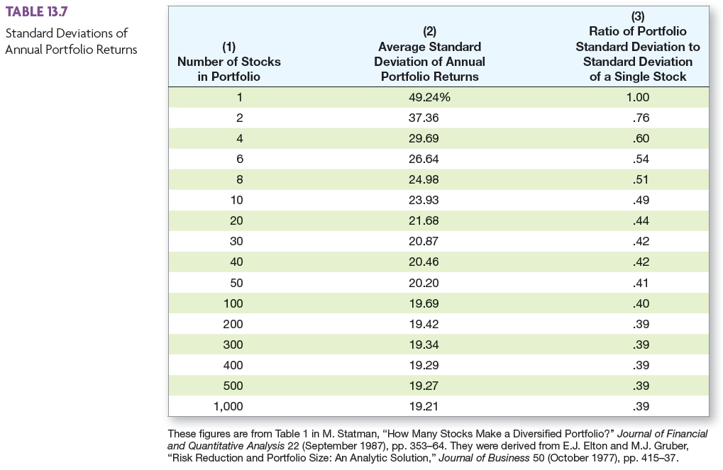

Slide 40
The Principle of Diversification
Diversification can substantially reduce the variability of returns without an equivalent reduction in expected returns
This reduction in risk arises because worse-than-expected returns from one asset are offset by better-than-expected returns from another
However, there is a minimum level of risk that cannot be diversified away and that is the systematic portion
Notes:
A discussion of the potential benefits of international investing may be helpful at this point.

Slide 41
Measuring Systematic Risk
How do we measure systematic risk?
We use the beta coefficient
What does beta tell us?
  A beta of 1 implies the asset has the same systematic risk as the overall market
  A beta < 1 implies the asset has less systematic risk than the overall market
  A beta > 1 implies the asset has more systematic risk than the overall market
Notes:
Lecture Tip: Remember that the cost of equity depends on both the firm’s business risk and its financial risk. So, all else equal, borrowing money will increase a firm’s equity beta because it increases the volatility of earnings. Robert Hamada derived the following equation to reflect the relationship between levered and unlevered betas (excluding tax effects):
βL = βU(1 + D/E)
where:
βL = equity beta of a levered firm;
βU = equity beta of an unlevered firm;
D/E = debt-to-equity ratio

Slide 42
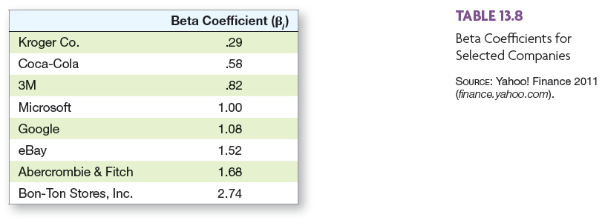
Actual Company Betas
Notes:
www: Click on the web surfer icon to go to screen.yahoo.com/stocks.html where you can do searches for various betas. Students are often interested to see the range of betas that are out there.
Lecture Tip: Students sometimes wonder just how high a stock’s beta can get. In earlier years, one would say that, while the average beta for all stocks must be 1.0, the range of possible values for any given beta is from -∞ to +∞.
Today, the Internet provides another way of addressing the question. Go to screen.yahoo.com/stocks.html. This site allows you to search many financial markets by fundamental criteria. For example, as of August 12, 2008, a search for stocks with betas of at least 2.00 turns up 1,228 stocks. Restricting the search to the S&P 500 (large-cap stocks) produces 26 stocks.

Slide 43
Work the Web Example
Many sites provide betas for companies
Yahoo Finance provides beta, plus a lot of other information under its Key Statistics link
Click on the web surfer to go to Yahoo Finance
  Enter a ticker symbol and get a basic quote
  Click on Key Statistics

Slide 44
Total vs. Systematic Risk
Consider the following information:
  Standard Deviation Beta
  Security C 20% 1.25
  Security K 30% 0.95
1. Which security has more total risk?
K because the standard deviation
is greater than C
2. Which security has more systematic risk?
C because the beta is larger than K
Notes:
Security K has the higher total risk
Security C has the higher systematic risk
Security C should have the higher expected return

Slide 45
Total vs. Systematic Risk
Consider the following information:
  Standard Deviation Beta
  Security C 20% 1.25
  Security K 30% 0.95
3. Which security should have the higher expected return?
C because beta measures risk and it’s expected return
Notes:
Security K has the higher total risk
Security C has the higher systematic risk
Security C should have the higher expected return

Slide 46
Example: Portfolio Betas
Consider the previous example with the following four securities:
  Security Weight Beta
  DCLK .133 2.685
  KO .2 0.195
  INTC .267 2.161
  KEI .4 2.434
What is the portfolio beta?
.133(2.685) + .2(.195) + .267(2.161) + .4(2.434)
= 1.947
Notes:
Which security has the highest systematic risk? DCLK
Which security has the lowest systematic risk? KO
Is the systematic risk of the portfolio more or less than the market? more

Slide 47
Beta and the Risk Premium
Remember that the risk premium = expected return – risk-free rate
The higher the beta, the greater the risk premium should be
Can we define the relationship between the risk premium and beta so that we can estimate the expected return?
  YES!

Slide 48
Example: Portfolio Expected Returns and Betas: The SML
E(R_{A})
R_{f}
β_{A}
Notes:
Based on the example in the book:
Point out that there is a linear relationship between beta and expected return. Ask if the students remember the form of the equation for a line.
Y = mx + b
E(R) = slope (Beta) + y-intercept
The y-intercept is = the risk-free rate, so all we need is the slope
Lecture Tip: The example in the book illustrates a greater than 100% investment in asset A. This means that the investor has borrowed money on margin (technically at the risk-free rate) and used that money to purchase additional shares of asset A. This can increase the potential returns, but it also increases the risk. More on this is provided in the IM.

Slide 49
Security Market Line
The security market line (SML) is the representation of market equilibrium
The slope of the SML is the reward-to-risk ratio: (E(R_{M}) – R_{f}) / β_{M}
But since the beta for the market is ALWAYS equal to one, the slope can be rewritten:
Slope = E(R_{M}) – R_{f} = market risk premium
Notes:
Based on the discussion earlier, we now have all the components of the line:
E(R) = [E(R_{M}) – R_{f}]β + R_{f}
Lecture Tip: Although the realized market risk premium has on average been approximately 8.5%, the historical average should not be confused with the anticipated risk premium for any particular future period. There is abundant evidence that the realized market return has varied greatly over time. The historical average value should be treated accordingly. On the other hand, there is currently no universally accepted means of coming up with a good ex ante estimate of the market risk premium, so the historical average might be as good a guess as any. In the late 1990’s, there was evidence that the risk premium had been shrinking. In fact, Alan Greenspan was concerned with the reduction in the risk premium because he was afraid that investors had lost sight of how risky stocks actually are. Investors had a wake-up call in late 2000 and 2001.

Slide 50
Reward-to-Risk Ratio: Definition and Example
The reward-to-risk ratio is the slope of the line illustrated in the previous example
  Slope = (E(R_{A}) – R_{f}) / (β_{A} – 0)
  Reward-to-risk ratio for previous example =
  (20 – 8) / (1.6 – 0) = 7.5
What if an asset has a reward-to-risk ratio of 8 (implying that the asset plots above the line)?
What if an asset has a reward-to-risk ratio of 7 (implying that the asset plots below the line)?
Notes:
Ask students if they remember how to compute the slope of a line: rise / run
If the reward-to-risk ratio = 8, then investors will want to buy the asset. This will drive the price up and the expected return down (remember time value of money and valuation). When will the flurry of trading stop? When the reward-to-risk ratio reaches 7.5.
If the reward-to-risk ratio = 7, then investors will want to sell the asset. This will drive the price down and the expected return up. When will the flurry of trading stop? When the reward-to-risk ratio reaches 7.5.

Slide 51
Market Equilibrium
In equilibrium, all assets and portfolios must have the same reward-to-risk ratio, and they all must equal the reward-to-risk ratio for the market

Slide 52

The Capital Asset Pricing Model (CAPM)
The capital asset pricing model defines
the relationship between risk and return:
E(R_{A}) = R_{f} + β_{A}(E(R_{M}) – R_{f})
If we know an asset’s systematic risk, we can use the CAPM to determine its expected return
This is true whether we are talking about financial assets or physical assets

Slide 53
Example - CAPM
Consider the betas for each of the assets given earlier. If the risk-free rate is 4.15% and the market risk premium is 8.5%,
What is the expected return for each?
Security | Beta | Expected Return
DCLK | 2.685 | 4.15 + 2.685(8.5) = 26.97%
KO | 0.195 | 4.15 + 0.195(8.5) = 5.81%
INTC | 2.161 | 4.15 + 2.161(8.5) = 22.52%
KEI | 2.434 | 4.15 + 2.434(8.5) = 24.84%
Notes:
Lecture Tip: Students should remember that in an efficient market, security investments have a NPV = 0, on average. However, the NPV does not imply that a company’s investments in new projects must have an NPV of zero. Firms attempt to invest in projects with a positive NPV, and those that are consistently successful will trade at higher prices, all else equal. The ability to generate positive NPV projects reflects the fundamental differences in physical asset markets and financial asset markets. Physical asset markets are generally less efficient than financial asset markets, and cash flows to physical assets are often owner dependent.

Slide 54
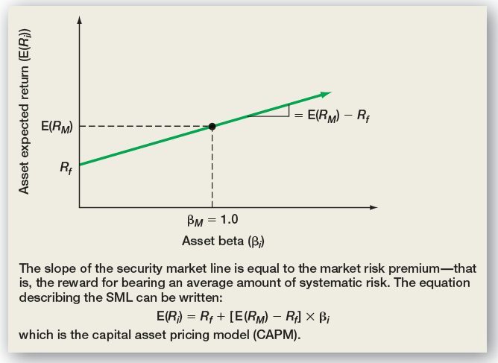
The CAPM

Slide 55
Quick Quiz
How do you compute the expected return and standard deviation for an individual asset? For a portfolio?
What is the difference between systematic and unsystematic risk?
What type of risk is relevant for determining the expected return?
Consider an asset with a beta of 1.2, a risk-free rate of 5%, and a market return of 13%.
  What is the reward-to-risk ratio in equilibrium?
  What is the expected return on the asset?
Notes:
Reward-to-risk ratio = 13 – 5 = 8%
Expected return = 5 + 1.2(8) = 14.6%

Slide 56
Comprehensive Problem
The risk free rate is 4%, and the required return on the market is 12%. What is the required return on an asset with a beta of 1.5?
What is the reward/risk ratio?
What is the required return on a portfolio consisting of 40% of the asset above and the rest in an asset with an average amount of systematic risk?
Notes:
R = .04 + 1.5 x (.12 - .04) = .16
The reward/risk ratio is 8%
R = (.4 x .16) + (.6 x .12) = .136

Slide 57
Terminology
Portfolio
Expected Return
Unsystematic Risk
Systematic Risk
Security Market Line (SML)
Beta
Capital Asset Pricing Model (CAPM)

Slide 58
Formulas
Expected return on an investment
Variance of an entire population, not a sample
Expected return on a portfolio

Slide 59
Formulas
Slope = E(R_{M}) – R_{f} = market risk premium
CAPM = E(R_{A}) = R_{f} + β_{A}(E(R_{M}) – R_{f})

