Slide 1

Chapter 2
Financial Statements, Taxes, and Cash Flow
McGraw-Hill/Irwin
Copyright © 2013 by The McGraw-Hill Companies, Inc. All rights reserved.
Notes:
Notes to the Instructor:
The PowerPoints are designed for an introductory finance class for undergraduates with the emphasis on the key points of each chapter
Each chapter’s PowerPoint is designed for active learning by the students in your classroom
Not everything in the book’s chapter is necessarily duplicated on the PowerPoint slides
There are two finance calculators used (when relevant). You can delete the slides if you don’t use both TI and HP business calculators
Animation is used extensively. You can speed up, slow down or eliminate the animation at your discretion. To do so just open a chapter PowerPoint and go to any slide you want to modify; click on “Animations” on the top of your PowerPoint screen tools; then click on “Custom Animations”. A set of options will appear on the right of your screen. You can “change” or “remove” any line of that particular slide using the icon on the top of the page. The speed is one of the three options on every animation under “timing”.
Effort has been made to maintain the basic “7x7” rule of good PowerPoint presentations.
Additional problems and/or examples are available on McGraw-Hill’s Connect.

Slide 2
Chapter Outline
The Balance Sheet
The Income Statement
Taxes
Cash Flow
2-2

Slide 3
Chapter Outline
The Balance Sheet
The Income Statement
Taxes
Cash Flow
2-3
2-3

Slide 4

Balance Sheet
The balance sheet is a snapshot of the
firm’s assets and liabilities at
a given point in time
Assets are listed in order
of decreasing liquidity
Liquidity is the ease of
conversion to cash
without significant
loss of value
Notes:
The Lecture Tip in the IM focuses on helping students see the big picture: all decisions relate to either investment or financing.
Liquidity is a very important concept. Students tend to remember the “convert to cash quickly” component of liquidity, but often forget the part about “without loss of value.” Remind them that we can convert anything to cash quickly if we are willing to lower the price enough, but that doesn’t mean it is liquid.
Also, point out that a firm can be TOO liquid. Excess cash holdings lead to overall lower returns. See the Lecture Tip in the IM for a more complete discussion of this issue.

Slide 5

Balance Sheet
The most important relationship you can bring to this class (from your accounting), is the formula of the “Balance Sheet Identity”:
Total Assets = Total Liabilities + Stockholders Equity
Notes:
The Lecture Tip in the IM focuses on helping students see the big picture: all decisions relate to either investment or financing.
Liquidity is a very important concept. Students tend to remember the “convert to cash quickly” component of liquidity, but often forget the part about “without loss of value.” Remind them that we can convert anything to cash quickly if we are willing to lower the price enough, but that doesn’t mean it is liquid.
Also, point out that a firm can be TOO liquid. Excess cash holdings lead to overall lower returns. See the Lecture Tip in the IM for a more complete discussion of this issue.

Slide 6
The Balance Sheet Figure 2.1
Notes:
The left-hand side lists the assets of the firm. Current assets are listed first because they are the most liquid. Fixed assets can include both tangible and intangible assets, and they are listed at the bottom because they generally are not very liquid. These are a direct result of management’s investment decisions. (Please emphasize that “investment decisions” are not limited to investments in financial assets.)
Note that the balance sheet does not list some very valuable assets, such as the people who work for the firm. The liabilities and equity (or ownership) components of the firm are listed on the right-hand side. This indicates how the assets are paid for. Since the balance sheet has to balance, total equity = total assets – total liabilities. The portion of equity that can most easily fluctuate to create this balance is retained earnings. The right-hand side of the balance sheet is a direct result of management’s financing decisions.
Remember that shareholders’ equity consists of several components and that total equity includes all of these components, not just the “common stock” item. In particular, remind students that retained earnings belong to the shareholders. See the Lecture Tip in the IM for further discussion.

Slide 7
Net Working Capital
NWC = Current Assets – Current Liabilities
Positive when the cash that will be received over the next 12 months exceeds the cash that will be paid out
Usually positive in a financially healthy firm
2-7
Notes:
After a basic accounting class, students may believe a higher current ratio (or, similarly, more cash on hand) is always better. So, it is good to remind students that a cash balance is a use of funds and has an opportunity cost. (See the Lecture Tip in the IM for more detail.)

Slide 8
Liquidity
Ability to convert to cash quickly without a significant loss in value
Liquid firms are less likely to experience financial distress
But liquid assets typically earn a lower return
Trade-off to find balance between liquid and illiquid assets
2-8
Notes:
After a basic accounting class, students may believe a higher current ratio (or, similarly, more cash on hand) is always better. So, it is good to remind students that a cash balance is a use of funds and has an opportunity cost. (See the Lecture Tip in the IM for more detail.)

Slide 9
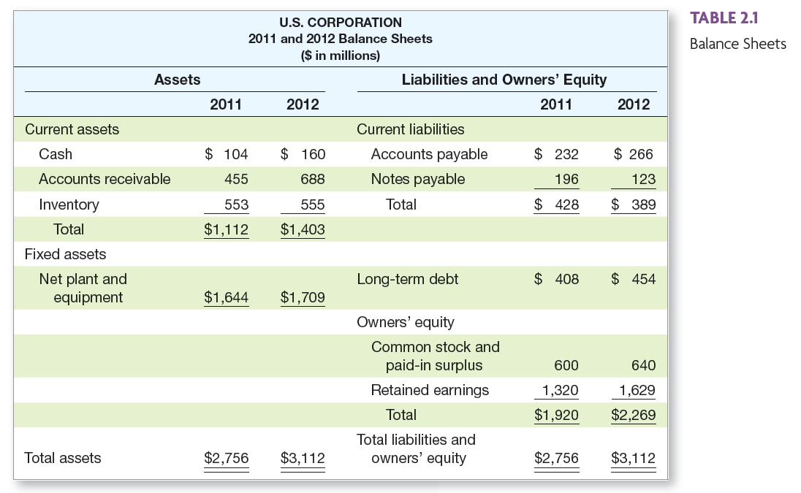
US Corporation Balance Sheet – Table 2.1
Place Table 2.1 (US Corp Balance Sheet) here
2-9
Notes:
The first example computing cash flows has a link to the information in this table. The arrow in the corner is used to return you to the example.
Here is an example of a simplified balance sheet. Many students make it through business school without ever seeing an actual balance sheet, particularly those who are not majoring in finance or accounting. I encourage you to bring in some annual reports and let the students see the differences between the simplified statements they see in textbooks and the real thing.
This is a good place to talk about some of the specific types of items that show up on a balance sheet and remind the students what accounts receivable, accounts payable, notes payable, etc. are.

Slide 10

Book Value
Versus
Market Value

Slide 11
Market Value vs. Book Value
The balance sheet provides the book value of the assets, liabilities, and equity.
Market value is the price at which the assets, liabilities, or equity can actually be bought or sold.
Notes:
Current assets and liabilities generally have book values and market values that are very close. This is not necessarily the case with the other assets, liabilities, and equity of the firm.
Assets are listed at historical costs less accumulated depreciation – this may bear little resemblance to what they could actually be sold for today. The balance sheet also does not include the value of many important assets, such as human capital. Consequently, the “Total Assets” line on the balance sheet is generally not a very good estimate of what the assets of the firm are actually worth. (See the Lecture Tip in the IM for more detail on this issue.)
Liabilities are listed at face value. When interest rates change or the risk of the firm changes, the value of those liabilities change in the market as well. This is especially true for longer-term liabilities.
Equity is the ownership interest in the firm. The market value of equity (stock price times number of shares) depends on the future growth prospects of the firm and on the market’s estimation of the current value of ALL of the assets of the firm.
The best estimate of the market value of the firm’s assets is market value of liabilities + market value of equity.
Market values are generally more important for the decision making process because they are more reflective of the cash flows that would occur today.

Slide 12
Market Value vs. Book Value Classroom Discussion Questions
1. Market value and book value are often very different. Why?
2. Which is more important to the decision-making process?
Notes:
Current assets and liabilities generally have book values and market values that are very close. This is not necessarily the case with the other assets, liabilities, and equity of the firm.
Assets are listed at historical costs less accumulated depreciation – this may bear little resemblance to what they could actually be sold for today. The balance sheet also does not include the value of many important assets, such as human capital. Consequently, the “Total Assets” line on the balance sheet is generally not a very good estimate of what the assets of the firm are actually worth. (See the Lecture Tip in the IM for more detail on this issue.)
Liabilities are listed at face value. When interest rates change or the risk of the firm changes, the value of those liabilities change in the market as well. This is especially true for longer-term liabilities.
Equity is the ownership interest in the firm. The market value of equity (stock price times number of shares) depends on the future growth prospects of the firm and on the market’s estimation of the current value of ALL of the assets of the firm.
The best estimate of the market value of the firm’s assets is market value of liabilities + market value of equity.
Market values are generally more important for the decision making process because they are more reflective of the cash flows that would occur today.

Slide 13
Example 2.2 Klingon Corporation
KLINGON CORPORATION
Balance Sheets
Market Value versus Book Value
 | Book | Market |  | Book | Market
Assets |  |  | Liabilities and Shareholders’ Equity
NWC | $ 400 | $ 600 | LTD | $ 500 | $ 500
NFA | 700 | 1,000 | SE | 600 | 1,100
 | 1,100 | 1,600 |  | 1,100 | 1,600
Notes:
Shareholders are the ones that benefit from increases in the market value of a firm’s assets. They are also the ones that bear the losses of a decrease in market value. Consequently, managers need to consider the impact of their decisions on the market value of assets, not on their book value. Here is a good illustration:
Suppose that the MV of assets declined to $700 and the market value of long-term debt remained unchanged. What would happen to the market value of equity? It would decrease to 700 – 500 = 200. (See Lecture Tips in the IM, as this may be a rationale for “marking-to-market.”)
The market-to-book ratio, which compares the market value of equity to the book value of equity, is often used by analysts as a measure of valuation for a stock. It is generally a bad sign if a company’s market-to-book ratio approaches 1.00 (meaning market value = book value) because of the GAAP employed in creating a balance sheet. It is definitely a bad sign if the ratio is less than 1.00.
GAAP does provide for some assets to be marked-to-market, primarily those assets for which current market values are readily available due to trading in liquid markets. However, it does not generally apply to long-term assets, where market values and book values are likely to differ the most.

Slide 14
Chapter Outline
The Balance Sheet
The Income Statement
Taxes
Cash Flow

Slide 15

Income Statement
The income statement is more like a video of the firm’s operations for a specified period of time.
You generally report revenues first and then deduct any expenses for the period.
Matching principle – GAAP says to show revenue when it accrues and match the expenses required to generate the revenue.
Notes:
Matching principle – this principle leads to non-cash deductions like depreciation. This is why net income is NOT a measure of the cash flow during the period.
Similar to a previous Lecture Tip, consider discussing that the top half of the income statement addresses investment decisions, whereas the bottom half deals with financing.
See the IM for a discussion of Global Crossing’s record “profit” during the first quarter of 2004.

Slide 16
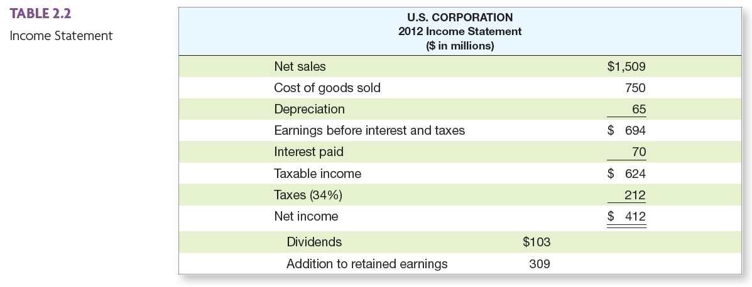
US Corporation Income Statement – Table 2.2
Notes:
The first example computing cash flows has a link to the information in this table. The arrow in the corner is used to return you to the example.
Remember that these are simplified income statements for illustrative purposes.
Earnings before interest and taxes is often called operating income.
COGS would include both the fixed costs and the variable costs needed to generate the revenues.
Analysts often look at EBITDA (earnings before interest, taxes, depreciation, and amortization) as a measure of the operating cash flow of the firm. It is not true in the strictest sense because taxes are an operating cash flow as well, but it does provide a reasonable estimate for analysis purposes.
The IM provides a discussion of Cendant and the problems that the company ran into when fraudulent accounting practices were discovered.
It is important to point out that depreciation expense is often figured two different ways, depending on the purpose of the financial statements. If we are computing the taxes that we will owe, we use the depreciation schedule provided by the IRS. In this instance, the “life” of the asset for depreciation purposes may be very different from the useful life of the asset. Statements that are prepared for investors often use straight-line depreciation because it will tend to have a lower depreciation charge than MACRs early in the asset’s life. This reduces the “expense,” and thus increases the firm’s reported EPS. This is a good illustration of why it is important to look at a firm’s cash flow and not just its EPS.

Slide 17
Work the Web Example
Publicly traded companies must file regular reports with the Securities and Exchange Commission
These reports are usually filed electronically and can be searched at the SEC public site called EDGAR
Click on the web surfer, pick a company, and see what you can find!

Slide 18
Chapter Outline
The Balance Sheet
The Income Statement
Taxes
Cash Flow

Slide 19

The Concept of Cash Flow
Cash flow is one of the most important pieces of information that a financial manager can derive from financial statements
The “Statement of Cash Flows” does not provide us with the same information that we are looking at here
We will look at how cash is generated from utilizing assets and how it is paid to those that finance the purchase of the assets.

Slide 20
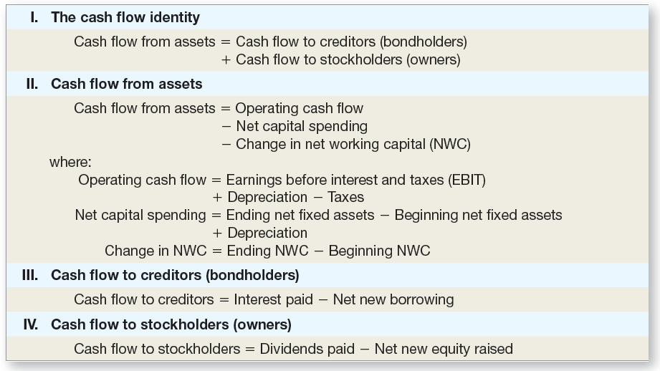
Cash Flow Summary Table 2.6
Notes:
This provides a summary for the various cash flow calculations. It is a good place to refer back when working on cash flows in the capital budgeting section.

Slide 21
Cash Flow From Assets
Cash Flow From Assets (CFFA) = Cash Flow to Creditors + Cash Flow to Stockholders
CFFA = CF to creditors + CF to Stockholders
Notes:
The first equation is how the cash flow from the firm is divided among the investors who financed the assets.
The second equation is the cash flow that the firm receives from its assets. This is an important equation to remember. We will come back to it and use it again when we do our capital budgeting analysis. We want to base our decisions on the timing and risk of the cash flows we expect to receive from a project.

Slide 22
Example of CCFA: Part I
CF to Creditors (B/S and I/S) = interest paid – net new borrowing = $24
CF to Stockholders (B/S and I/S) = dividends paid – net new equity raised = $63
CFFA = CF to creditors + CF to Stockholders
CFFA = 24 + 63 = $87
Notes:
Use the information from the balance sheet and income statement presented previously to work through this example. There is a hyperlink on “I/S” that will take you to that slide. Another one exists on “B/S.” The arrows on the Income Statement and Balance Sheet slides will bring you back here.
Net New Borrowing = ending LT debt – beginning LT debt = 454 – 408 = 46
CF to creditors = 70 – 46 = 24
Net New Equity = 640 – 600 = 40 (Be sure to point out that we want equity raised in the capital markets, not retained earnings).
CF to Stockholders = 103 – 40 = 63

Slide 23
Cash Flow From Assets
Cash Flow From Assets = Operating Cash Flow – Net Capital Spending – Changes in NWC
CFFA = OCF – NCS - ∆NWC
Notes:
The first equation is how the cash flow from the firm is divided among the investors who financed the assets.
The second equation is the cash flow that the firm receives from its assets. This is an important equation to remember. We will come back to it and use it again when we do our capital budgeting analysis. We want to base our decisions on the timing and risk of the cash flows we expect to receive from a project.

Slide 24
Example of CCFA: Part II
OCF (I/S) = EBIT + depreciation – taxes = $547
NCS ( B/S and I/S) = ending net fixed assets – beginning net fixed assets + depreciation = $130
Changes in NWC (B/S) = ending NWC – beginning NWC = $330
CFFA = OCF – NCS - ∆NWC
CFFA = 547 – 130 – 330 = $87
Notes:
Use the information from the balance sheet and income statement presented previously to work through this example. There is a hyperlink on “I/S” that will take you to that slide. Another one exists on “B/S.” The arrows on the Income Statement and Balance Sheet slides will bring you back here.
OCF = 694 + 65 – 212 = 547
NCS = 1709 – 1644 + 65 = 130
Students often have a difficult time understanding why a cash outflow has a positive sign and a cash inflow has a negative sign. Emphasize that we are talking about SPENDING in the net capital spending formula and Investment in NWC. The formula for CFFA takes care of reducing cash flow when NCS is positive and increasing CF when it is negative.
Ending NWC = 1403 – 389 = 1014
Beginning NWC = 1112 – 428 = 684
Changes in NWC = 1014 – 684 = 330

Slide 25
The Big Picture Problem: Balance Sheet and Income Statement Information
Current Accounts
2009: CA = 3625; CL = 1787
2008: CA = 3596; CL = 2140
Fixed Assets and Depreciation
2009: NFA = 2194; 2008: NFA = 2261
Depreciation Expense = 500
Long-term Debt and Equity
2009: LTD = 538; Common stock & APIC = 462
2008: LTD = 581; Common stock & APIC = 372
Income Statement
EBIT = 1014; Taxes = 368
Interest Expense = 93; Dividends = 285

Slide 26
Task: use the information on the previous slide to compute the following:
OCF
NCS
Changes in NWC
CFFA
CF to Creditors
CF to Stockholders
CFFA
Does the CF identity hold?

Slide 27
Cash Flow Problem Answers:
OCF = 1,014 + 500 – 368 = 1,146
NCS = 2,194 – 2,261 + 500 = 433
Changes in NWC = (3,625 – 1,787) – (3,596 – 2,140) = 382
CFFA = 1,146 – 433 – 382 = 331
CF to Creditors = 93 – (538 – 581) = 136
CF to Stockholders = 285 – (462 – 372) = 195
CFFA = 136 + 195 = 331
The CF identity holds!

Slide 28
Quick Quiz
What is the difference between book value and market value? Which should we use for decision-making purposes?
What is the difference between accounting income and cash flow? Which do we need to use when making decisions?

Slide 29
Quick Quiz
What is the difference between average and marginal tax rates? Which should we use when making financial decisions?
How do we determine a firm’s cash flows? What are the equations, and where do we find the information?

Slide 30
Comprehensive Problem
Current Accounts
2009: CA = 4,400; CL = 1,500
2008: CA = 3,500; CL = 1,200
Fixed Assets and Depreciation
2009: NFA = 3,400; 2008: NFA = 3,100
Depreciation Expense = 400
Long-term Debt and Equity (R.E. not given)
2009: LTD = 4,000; Common stock & APIC = 400
2008: LTD = 3,950; Common stock & APIC = 400
Income Statement
EBIT = 2,000; Taxes = 300
Interest Expense = 350; Dividends = 500
Task: Compute the CFFA
Notes:
OCF = $2,000 + $400 – $300 = $2,100
NCS = $ 3,400 – $3,100 + $400 = $700
Changes in NWC = ($4,400 – $1,500) – ($3,500 – $1,200) = $600
CFFA = $2,100 – $700 - $600 = $800
CF to Creditors = $350 – ($4,000 – $3,950) = $300
CF to Stockholders = $500
CFFA = $300 + $500 = $800

Slide 31
Terminology
Book Value of a Company
Market Value of a Company
Net Working Capital (NWC)
Liquidity
Cash Flow from Assets (CFFA)

Slide 32
Formulas
Total Assets = Total Liabilities + Stockholders Equity
CFFA = CF to creditors + CF to Stockholders
CFFA = OCF – NCS - ∆NWC

