Slide 1

Chapter 5
Introduction to Valuation: The Time Value
of Money
McGraw-Hill/Irwin
Copyright © 2013 by The McGraw-Hill Companies, Inc. All rights reserved.

Slide 2
Chapter Outline
Time and Money
Future Value and Compounding
Present Value and Discounting
More about Present and Future Values

Slide 3
Chapter Outline
Time and Money
Future Value and Compounding
Present Value and Discounting
More about Present and Future Values

Slide 4


Time and Money
The single most important skill for a student to learn in this course is the manipulation of money through time.

Slide 5

Time and Money
We will use the time line to visually represent items over time.
Let’s start with fruit….. yes, fruit!
Notes:
This fruit analogy may seem odd, but many students automatically want to add up money over time and tell you the total of funds received. This approach gives those visual learners an opportunity to appreciate that money distributed over time has a different value and the task in finance is to help the students understand the time/dollar value relationship.

Slide 6

Time and Money
If I gave you apples, one per year, then you can easily conclude that I have given you a total of three apples.
Visually this would look like:
Today
1 Year
2 Years

Slide 7
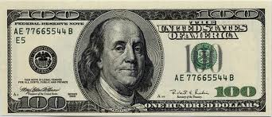
Time and Money
But money doesn’t work this way.
If I gave you $100 each year, how much would you have, in total?
$300, right?
Today
1 Year
2 Years

Slide 8
Time and Money
But money doesn’t work this way.
If I gave you $100 each year, how much would you have, in total?
$300, right?
Today
1 Year
2 Years

Slide 9
Time and Money
The difference between money and fruit is that money can work for you over time, earning interest.
Today
1 Year
2 Years

Slide 10
Time and Money
Which would you rather receive: A or B?
A
Today
1 Year
2 Years
B
Today
1 Year
2 Years
Notes:
A provides you $300 today but B provides you $300 total but spread out over three years. This is the critical message for students to grasp: money spread out over time is not equal in value to money all given today.

Slide 11
Time and Money
A is better because you get all of the $300 today instead of having to wait two years.
A
Today
1 Year
2 Years
B
Today
1 Year
2 Years
Notes:
A provides you $300 today but B provides you $300 total but spread out over two years. This is the critical message for students to grasp: money spread out over time is not equal in value to money all given today.

Slide 12
Time and Money
Receiving money one year from now, or two years from now, is different than getting all the money today.
Today
1 Year
2 Years

Slide 13


Time and Money
So going back to the fruit analogy, receiving money over time is like receiving different fruits over time.
Today
1 Year
2 Years

Slide 14
Time and Money
And you don’t mix fruits in finance! Thus every time you see money spread out over time, you must think of the money as different; you can’t just add it up!
Today
1 Year
2 Years

Slide 15

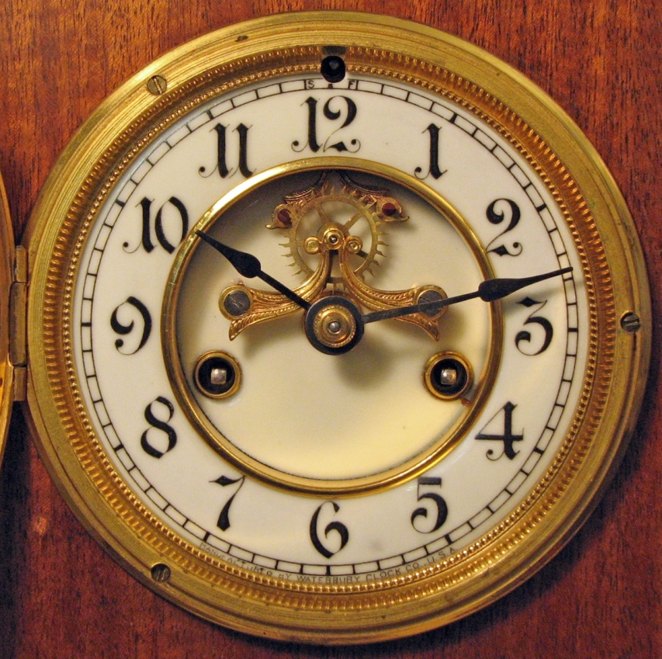
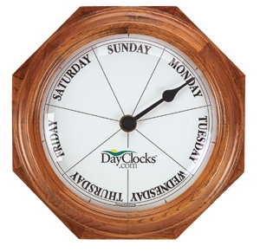


Time and Money
The difference between fruit (and anything else) and money is that money changes value over time.
Notes:
The focus on the fact that a dollar given in the future is not worth as much today is the principle message for students to receive. Once understood, then students can focus on how to compute the value change over time which leads directly into the financial equations for time and money.

Slide 16
Time and Money
Money received over time
is not equal in value.
So how do we “value” future money?
That’s the $64,000 question!
Today
1 Year
2 Years

Slide 17
Chapter Outline
Time and Money
Future Value and Compounding
Present Value and Discounting
More about Present and Future Values

Slide 18
Basic Definitions
Present Value – earlier money on a time line
Future Value – later money on a time line
Interest rate – “exchange rate” between earlier money and later money
Discount rate
Cost of capital
Opportunity cost of capital
Required return or required rate of return
Notes:
It’s important to point out that there are many different ways to refer to the interest rate that we use in time value of money calculations. Students often get confused with the terminology, especially since they tend to think of an “interest rate” only in terms of loans and savings accounts.

Slide 19
Future Values
Suppose you invest $1,000 for one year at 5% per year.
What is the future value in one year?
Interest = 1,000(.05) = 50
Value in one year = principal + interest = 1,000 + 50 = 1,050
Future Value (FV) = 1,000(1 + .05) = $1,050
Today
1 Year
2 Years
?
$1,000
$1,050
Notes:
Students can easily relate to the concept of investing or putting money in a savings account and earning interest.
Point out that we are just using algebra when deriving the FV formula. We have 1,000(1) + 1,000(.05) = 1,000(1+.05)

Slide 20
Future Values
Suppose you leave the money in for another year.
How much will you have two years from now?
FV = 1,000(1.05)(1.05)
= 1,000(1.05)² = $1,102.50
Today
1 Year
2 Years
?
$1,000
$1,050
$1,102.60
Notes:
Point out that we are just using algebra when deriving the FV formula. We have 1,000(1) + 1,000(.05) = 1,000(1+.05)

Slide 21
Future Values: General Formula
FV = PV(1 + r)^{t}
FV = future value
PV = present value
r = period interest rate, expressed as
a decimal
t = number of periods
Notes:
This is THE most important formula in finance!

Slide 22
Future Values: General Formula
FV = PV(1 + r)^{t}
(1 + r)^{t} = the future value
interest factor

Slide 23
Effects of Compounding
Simple interest
Compound interest
Consider the previous example:
FV with simple interest = 1,000 + 50 + 50 = $1,100
FV with compound interest = $1,102.50
The extra $2.50 comes from the interest of .05(50) = $2.50 earned on the first interest payment or “interest on interest”
Notes:
It is important that students understand the impact of compounding now, or they will have more difficulty distinguishing when it is appropriate to use the APR and when it is appropriate to use the effective annual rate.

Slide 24
Using Your Financial Calculator
Texas Instruments BA-II Plus
FV = future value
PV = present value
I/Y = period interest rate
P/Y must equal 1 for the I/Y to be the period rate
Interest is entered as a percent, not a decimal
N = number of periods
Remember to clear the registers
(CLR TVM) after each problem
Notes:
I am providing information on the Texas Instruments BA-II Plus and the HP 12C. If you recommend or require a specific calculator other than these, you may want to make the appropriate changes.
Notes for the TI calculators: the more information students have to remember to enter, the more likely they are to make a mistake. For this reason, I normally tell my students to set P/Y = 1 and leave it that way. Then I teach them to work on a period basis, which is consistent with using the formulas. If you want them to use the P/Y function, remind them that they will need to set it every time they work a new problem and that CLR TVM does not affect P/Y.
If students are having difficulty getting the correct answer, make sure they have done the following:
Set decimal places to floating point (2nd Format, Dec = 9 enter) or show 4 to 5 decimal places if using an HP
Double check and make sure P/Y = 1; the factory setting is monthly (or P/Y = 12). Once changed, it will stay at P/Y = 1.
Make sure to clear the TVM registers after finishing a problem (or before starting a problem) It is important to point out that CLR TVM clears the FV, PV, N, I/Y and PMT registers. C/CE and CLR Work DO NOT affect the TVM keys
The remaining slides will work the problems using the notation provided above for calculator keys. The formulas are presented in the notes section.
Notes on the HP 12C. For practical purposes, the HP is much easier for a student new to the finance calculator as it requires far fewer key strokes and does not have a “CPT” compute key. It also is factory preset for annual compounding and clearing the calculator is simply a matter of “f” + “CLX” keys.
Lecture Tip: for PV and FV computations using the calculator, we are going to use only four keys: FV, PV, I/Y (or i), and N. An observation of each calculator will reveal that these four keys are clustered in a row (third row on the BAII Plus and first row on the HP 12C). In the next chapter, the use of the payment key (PMT) will be presented. When we present the bond chapter, we’ll use the PMT key and then not use any other key until we get to project evaluation where we will use the financial calculator’s capability to produce NPV and IRR using the memory function of the calculator.

Slide 25
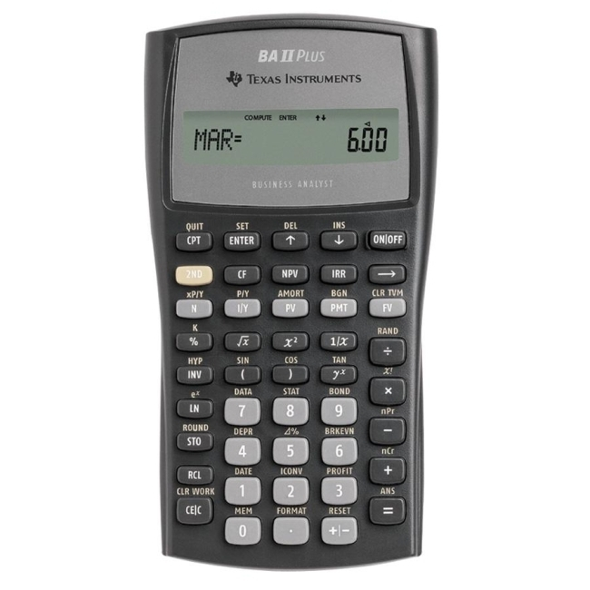

Slide 26
Using Your Financial Calculator
Hewlett-Packard 12C
FV = future value
PV = present value
i = period interest rate
Interest is entered as a percent,
not a decimal
n = number of periods
Remember to clear the registers
(“f” + “CLX”) after each problem
Notes:
I am providing information on the Texas Instruments BA-II Plus and the HP 12C. If you recommend or require a specific calculator other than these, you may want to make the appropriate changes.
Notes for the TI calculators: the more information students have to remember to enter, the more likely they are to make a mistake. For this reason, I normally tell my students to set P/Y = 1 and leave it that way. Then I teach them to work on a period basis, which is consistent with using the formulas. If you want them to use the P/Y function, remind them that they will need to set it every time they work a new problem and that CLR TVM does not affect P/Y.
If students are having difficulty getting the correct answer, make sure they have done the following:
Set decimal places to floating point (2nd Format, Dec = 9 enter) or show 4 to 5 decimal places if using an HP
Double check and make sure P/Y = 1; the factory setting is monthly (or P/Y = 12). Once changed, it will stay at P/Y = 1.
Make sure to clear the TVM registers after finishing a problem (or before starting a problem) It is important to point out that CLR TVM clears the FV, PV, N, I/Y and PMT registers. C/CE and CLR Work DO NOT affect the TVM keys
The remaining slides will work the problems using the notation provided above for calculator keys. The formulas are presented in the notes section.
Notes on the HP 12C. For practical purposes, the HP is much easier for a student new to the finance calculator as it requires far fewer key strokes and does not have a “CPT” compute key. It also is factory preset for annual compounding and clearing the calculator is simply a matter of “f” + “CLX” keys.

Slide 27
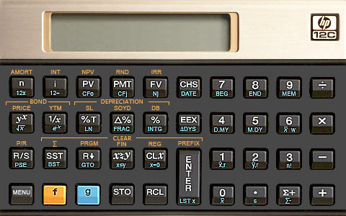

Slide 28
Future Values – Example 2
Suppose you invest the $1,000 from the previous example for 5 years.
How much would you have at time 5?
Today
1
2
3
4
5
?
$1,000
Notes:
We’re still using 5% interest.
Now is an important time to discuss the sign convention in the calculator. The calculator is programmed so that cash outflows are entered as negative and inflows are entered as positive. If you enter the PV as positive, the calculator assumes that you have received a loan that you will have to repay at some point. The negative sign on the future value indicates that you would have to repay $1,276.28 in 5 years. Show the students that if they enter the 1,000 as negative, the FV will compute as a positive number.
Also, you may want to point out the change sign key on the calculator. There seems to be a few students each semester that have never had to use it before.
Calculator: N = 5; I/Y = 5; PV = 1,000; CPT FV = -1,276.28
Formula: FV = 1,000(1.05)⁵ = 1,000(1.27628) = 1,276.28

Slide 29
TI BA II Plus
5 years = N
1276.28
5% = I/Y
-$1,000 = PV
1st
CPT
? = FV
2nd

Slide 30
5 years = N
HP 12-C
5% = i
-$1,000 = PV
? = FV
1276.28

Slide 31
Future Values – Example 2
Suppose you invest the $1,000 from the previous example for 5 years.
How much would you have at time 5?
Today
1
2
3
4
5
?
$1,000
$1,276.28
Notes:
Now is an important time to discuss the sign convention in the calculator. The calculator is programmed so that cash outflows are entered as negative and inflows are entered as positive. If you enter the PV as positive, the calculator assumes that you have received a loan that you will have to repay at some point. The negative sign on the future value indicates that you would have to repay $1,276.28 in 5 years. Show the students that if they enter the 1,000 as negative, the FV will compute as a positive number.
Formula: FV = 1,000(1.05)⁵ = 1,000(1.27628) = 1,276.28

Slide 32
Future Values – Example 2
The effect of compounding is small for a small number of periods, but increases as the number of periods increases.
(Simple interest would have a future value of $1,250, for a difference of $26.28.)

Slide 33
Future Values - Example 3
Suppose you had a relative deposit $10 at 5.5% 200 years ago. How much will you have today?
200 years ago
Today
?
$10
Notes:
You might also want to point out that it doesn’t matter what order you enter the information into the calculator.
Calculator: N = 200; I/Y = 5.5; PV = 10; CPT FV = -447,198.84
Formula: FV = 10(1.055)²⁰⁰ = 10(44,718.9838) = 447,189.84

Slide 34
TI BA II Plus
200 years = N
-447,189.84
5.5% = I/Y
-$10 = PV
1st
CPT
? = FV
2nd
5-34

Slide 35
200 years = N
HP 12-C
5.5% = i
-$10 = PV
? = FV
-447,189.84

Slide 36
Future Values-Example 3
Suppose you had a relative deposit $10 at 5.5% 200 years ago.
How much will you have today?
FV = 10(1.055)²⁰⁰
= 10 (44,718.9839) = $447,189.84
200 years ago
Today
?
$10
$447,189.84
Notes:
You might also want to point out that it doesn’t matter what order you enter the information into the calculator.
Formula: FV = 10(1.055)²⁰⁰ = 10(44,718.9838) = 447,189.84

Slide 37



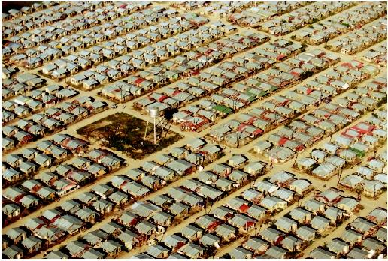
Future Value as a General Growth Formula
The formula for growth works for money, but it also works for numerous other variables:
Bacteria
Housing
Epidemics
Production

Slide 38
Future Value as a General Growth Formula
Suppose your company expects to increase unit sales of widgets by 15% per year for the next 5 years. If you sell 3 million widgets in the current year, how many widgets do you expect to sell in the fifth year?
5 N;15 I/Y; 3,000,000 PV
CPT FV = -6,034,072 units
(remember the sign convention)
Notes:
Calculator: N = 5; I/Y = 15; PV = 3,000,000 CPT FV = -6,034,072
Formula: FV = 3,000,000(1.15)⁵ = 3,000,000(2.011357187) = 6,034,072
This example also presents a good illustration of the Rule of 72, which approximates the number of years it will take to double an initial amount at a given rate. In this example, 72/15 = 4.8, or approximately 5 years.

Slide 39
Quick Quiz
What is the difference between simple interest and compound interest?
Suppose you have $500 to invest and you believe that you can earn 8% per year over the next 15 years.
How much would you have at the end of 15 years using compound interest?
How much would you have using simple interest?
Notes:
N = 15; I/Y = 8; PV = 500; CPT FV = -1,586.08
Formula: 500(1.08)¹⁵ = 500(3.172169) = 1,586.08

Slide 40
Chapter Outline
Time and Money
Future Value and Compounding
Present Value and Discounting
More about Present and Future Values

Slide 41
Present Values
If we can go forward in time to the future (FV), then why can’t we go backward in time to the present (PV)?
We can!
As a matter of fact, finance uses the process of moving future funds back into the present when we value financial instruments like bonds, preferred stock, and common stock. We also use it to evaluate investing in projects.
Notes:
Future chapters of the book will focus on the valuation of bonds, preferred stock, common stock, and projects

Slide 42
Present Values
If we can go forward in time to the future (FV), then why can’t we go backward in time to the present (PV)?
We can! All we need to do is refocus our concept of moving money through time.
Today
1
2
3
4
5
PV
FV
Notes:
Future chapters of the book will focus on the valuation of bonds, preferred stock, common stock, and projects

Slide 43
Present Values
How much do I have to invest today to have some amount in the future?
FV = PV(1 + r)^{t}
Rearrange to solve for PV:
PV = FV / (1 + r)^{t}
Notes:
Point out that the PV interest factor = 1 / (1 + r)^{t}

Slide 44
Present Values
When we talk about “discounting”, we mean finding the present value of some future amount.
When we talk about the “value” of something, we are talking about the present value unless we specifically indicate that we want the future value.

Slide 45
PV and FV
Finance uses “compounding” as the verb for going into the future and “discounting” as the verb to bring funds into the present.
Today
1
2
3
4
5
PV
Compounding
FV
Today
1
2
3
4
5
PV
Discounting
FV

Slide 46
Present Value: One Period Example
Suppose you need $10,000 in one year for the down payment on a new car. If you can earn 7% annually, how much do you need to invest today?
PV = 10,000 / (1.07)¹ = $9,345.79
Calculator
1 N; 7 I/Y; 10,000 FV
CPT PV = -9,345.79
Notes:
Lecture Tip: It may be helpful to utilize the example of $100 compounded at 10 percent to emphasize the present value concept. Start with the basic formula: FV = PV(1 + r)t and rearrange to find PV = FV / (1 + r)t. Students should recognize that the discount factor is the inverse of the compounding factor. Ask the class to determine the present value of $110 and $121 if the amounts are received in one year and two years, respectively, and the interest rate is 10%. Then demonstrate the mechanics: $100 = $110 (1 / 1.1) = 110 (.9091) $100 = $121 (1 / 1.12) = 121(.8264)
The students should recognize that it was an initial investment of $100 invested at 10% that created these two future values.

Slide 47
Present Values-Example 1
Suppose you need $10,000 in one year for the down payment on a new car. If you can earn 7% annually.
PV = 10,000 / (1.07)¹
= -$9,345.79
Today
I/Y (i) = 7%
1
?
$9,345.79
$10,000
How much do you need to invest today?
Notes:
Lecture Tip: It may be helpful to utilize the example of $100 compounded at 10 percent to emphasize the present value concept. Start with the basic formula: FV = PV(1 + r)t and rearrange to find PV = FV / (1 + r)t. Students should recognize that the discount factor is the inverse of the compounding factor. Ask the class to determine the present value of $110 and $121 if the amounts are received in one year and two years, respectively, and the interest rate is 10%. Then demonstrate the mechanics: $100 = $110 (1 / 1.1) = 110 (.9091) $100 = $121 (1 / 1.12) = 121(.8264)
The students should recognize that it was an initial investment of $100 invested at 10% that created these two future values.

Slide 48
TI BA II Plus
1 years = N
-9,345.79
7% = I/Y
$10,000 = FV
1st
CPT
? = PV
2nd
5-48

Slide 49
1 years = N
HP 12-C
7% = i
$10,000 = FV
? = PV
-9,345.79

Slide 50
Present Values – Example 2
You want to begin saving for your daughter’s college education and you estimate that she will need $150,000 in 17 years. If you feel confident that you can earn 8% per year, how much do you need to invest today?
N = 17; I/Y = 8; FV = 150,000
CPT PV = -$40,540.34
(remember the sign convention)
Today
I/Y (i) = 8%
17
?
$40,540.34
$150,000
Notes:
The remaining visual examples will just use the calculator keys.
Formula: 150,000 / (1.08)¹⁷ = 150,000(.270268951) = 40,540.34
We can use a negative exponent to avoid having to invert and multiply by the result from (1 + r)^n:
Key strokes: 1.08 y^{x} 17 +/- = x 150,000 = 40,540.34

Slide 51
Present Values – Example 3
Your parents set up a trust fund for you 10 years ago that is now worth $19,671.51. If the fund earned 7% per year. How much is your initial investment?
N = 10; I/Y = 7; FV = $19,671.51
CPT PV = -$10,000
(remember the sign convention)
Today
I/Y (i) = 7%
10
?
$10,000
$19,671.51
Notes:
The actual number computes to –9999.998. This is a good place to remind the students to pay attention to what the question asked, and to be reasonable in their answers. A little common sense should tell them that the original amount was 10,000 and that the calculation doesn’t come out exactly because the future value is rounded to the nearest cent.
Calculator: N = 10; I/Y = 7; FV = 19,671.51; CPT PV = -10,000

Slide 52
Present Value Important Relationship I
For a given interest rate – the longer the time period, the lower the present value
What is the present value of $500 to be received in 5 years? 10 years? The discount rate is 10%
5 years: N = 5; I/Y = 10; FV = 500 CPT PV = -$310.46
10 years: N = 10; I/Y = 10; FV = 500 CPT PV = -$192.77
Notes:
Remember the sign convention.
Calculator: 5 years: N = 5; I/Y = 10; FV = 500; CPT PV = -310.46
N = 10; I/Y = 10; FV = 500; CPT PV = -192.77
Formulas: PV = 500 / (1.1)⁵ = 500(.620921323) = 310.46
PV = 500 / (1.1)¹⁰ = 500(.385543289) = 192.77

Slide 53
Present Value Important Relationship II
For a given time period – the higher the interest rate, the smaller the present value
What is the present value of $500 received in 5 years if the interest rate is 10%? 15%?
Rate = 10%: N = 5; I/Y = 10; FV = 500 CPT PV = -$310.46
Rate = 15%; N = 5; I/Y = 15; FV = 500 CPT PV = -$248.59
Notes:
Calculator: 10%: N = 5; I/Y = 10; FV = 500; CPT PV = 310.46
15%: N = 5; I/Y = 15; FV = 500; CPT PV = 248.59
Formulas: PV = 500 / (1.1)⁵ = 500(.620921323) = 310.46
PV = 500 / (1.15)⁵ = 500(.497176735) = 248.59
Since there is a reciprocal relationship between PVIFs and FVIFs, you should also point out that future values increase as the interest rate increases.

Slide 54
The Basic PV Equation Review
PV = FV / (1 + r)^{t}
There are four parts to this equation:
1 = PV; 2 = FV; 3 = r; and 4 = t
If we know any three, we can solve for the fourth
If you are using a financial calculator, be sure to remember the sign convention or you will receive an error (or a nonsense answer) when solving for r or t
Notes:
Lecture Tip: Students who fail to grasp the concept of time value often do so because it is never really clear to them that given a 10% opportunity rate, $110 to be received in one year is equivalent to having $100 today (or $90.90 one year ago, or $82.64 two years ago, etc.). At its most fundamental level, compounding and discounting are nothing more than using a set of formulas to find equivalent values at any two points in time. In economic terms, one might stress that equivalence just means that a rational person will be indifferent between $100 today and $110 in one year, given a 10% opportunity. This is true because she could (a) take the $100 today and invest it to have $110 in one year or (b) she could borrow $100 today and repay the loan with $110 in one year. A corollary to this concept is that one can’t (or shouldn’t) add, subtract, multiply or divide money values in different time periods unless those values are expressed in equivalent terms, i.e., at a single point in time.

Slide 55
Quick Quiz II
What is the relationship between present value and future value?
Suppose you need $15,000 in 3 years. If you can earn 6% annually, how much do you need to invest today?
If you could invest the money at 8%, would you have to invest more or less than at 6%? How much?
Notes:
Relationship: The mathematical relationship is PV = FV / (1 + r)^{t}. One of the important things for them to take away from this discussion is that the present value is always less than the future value when we have positive rates of interest.
N = 3; I/Y = 6; FV = 15,000; CPT PV = -12,594.29
PV = 15,000 / (1.06)³ = 15,000(.839619283) = 12,594.29
N = 3; I/Y = 8; FV = 15,000; CPT PV = -11,907.48 (Difference = 686.81)
PV = 15,000 / (1.08)³ = 15,000(.793832241) = 11,907.48

Slide 56
Chapter Outline
Time and Money
Future Value and Compounding
Present Value and Discounting
More about Present and Future Values

Slide 57
Discount Rate
Often we will want to know what the implied interest rate is on an investment
Rearrange the basic PV equation and solve for r:
FV = PV(1 + r)^{t}
r = (FV / PV)^{1/t} – 1
Notes:
While the calculators label this as the “I/Y” key or the “i” key, the label for the variable of interest rate/discount rate is “r”. We will maintain this convention throughout the book.

Slide 58
Discount Rate – Example 1
You are looking at an investment that will pay $1,200 in 5 years if you invest $1,000 today. What is the implied rate of interest?
r = (1,200 / 1,000)^{1/5} – 1 = .03714 = 3.714%
Calculator note – the sign convention matters (for the PV)!
N = 5
PV = -1,000 (you pay 1,000 today)
FV = 1,200 (you receive 1,200 in 5 years)
CPT I/Y = 3.714%
Notes:
It is very important at this point to make sure that the students have more than 2 decimal places visible on their calculator.
If you are using formulas, you will want to make use of both the y^{x} and the 1/x keys.
Efficient key strokes for formula: 1,200 / 1,000 = y^{x} 5 1/x = - 1 = .03714
If they receive an error when they try to use the financial keys, they probably forgot to enter one of the numbers as a negative.

Slide 59
Discount Rate – Example 2
Suppose you are offered an investment that will allow you to double your money in 6 years. You have $10,000 to invest. What is the implied rate of interest?
N = 6
PV = -10,000
FV = 20,000
CPT I/Y = 12.25%
Notes:
Calculator: N = 6; FV = 20,000; PV = 10,000; CPT I/Y = 12.25%
Formula: r = (20,000 / 10,000)^{1/6} – 1 = .122462 = 12.25%

Slide 60
Discount Rate – Example 3
Suppose you have a 1-year old son and you want to provide $75,000 in 17 years towards his college education. You currently have $5,000 to invest. What interest rate must you earn to have the $75,000 when you need it?
N = 17; PV = -5,000; FV = 75,000
CPT I/Y = 17.27%
Notes:
Calculator: N = 17; FV = 75,000; PV = 5,000; CPT I/Y = 17.27%
Formula: r = (75,000 / 5,000)^{1/17} – 1 = .172686 = 17.27%
This is a great problem to illustrate how TVM can help you set realistic financial goals and possibly adjust your expectations based on what you can currently afford to save.

Slide 61
Quick Quiz III
What are some situations in which you might want to know the implied interest rate?
You are offered the following investments:
You can invest $500 today and receive $600 in 5 years. The investment is low risk.
You can invest the $500 in a bank account paying 4%.
What is the implied interest rate for the first choice, and which investment should you choose?
Notes:
Implied rate: N = 5; PV = -500; FV = 600; CPT I/Y = 3.714%
r = (600 / 500)^{1/5} – 1 = 3.714%
Choose the bank account because it pays a higher rate of interest (assuming tax rates and other issues are consistent across both investments).
How would the decision be different if you were looking at borrowing $500 today and either repaying at 4%, or repaying $600? In this case, you would choose to repay $600 because you would be paying a lower rate.

Slide 62
Finding the Number of Periods
Start with the basic equation and solve for t (remember your logs)
FV = PV(1 + r)^{t}
t = ln(FV / PV) / ln(1 + r)
You can use the financial keys on the calculator as well; just remember the sign convention.
Notes:
We have covered three of the four keys on the calculator: PV, FV, and i. This slide now presents solving for the fourth key: N.
Remind the students that ln is the natural logarithm and can be found on the calculator.
The rule of 72 is a quick way to estimate how long it will take to double your money: # years to double = 72 / r, where r is number of percent.

Slide 63
Number of Periods: Example 1
You want to purchase a new car, and you are willing to pay $20,000. If you can invest at 10% per year and you currently have $15,000, how long will it be before you have enough money to pay cash for the car?
I/Y = 10; PV = -15,000; FV = 20,000
CPT N = 3.02 years
Notes:
Calculator: I/Y = 10; FV = 20,000; PV = 15,000; CPT N = 3.02 years
Formula: t = ln(20,000 / 15,000) / ln(1.1) = 3.02 years

Slide 64
Number of Periods: Example 2
Suppose you want to buy a new house. You currently have $15,000, and you figure you need to have a 10% down payment plus an additional 5% of the loan amount for closing costs. Assume the type of house you want will cost about $150,000 and you can earn 7.5% per year. How long will it be before you have enough money for the down payment and closing costs?

Slide 65
Number of Periods: Example 2 (Continued)
How much do you need to have in the future?
Down payment = .1(150,000) = 15,000
Closing costs = .05(150,000 – 15,000) = 6,750
Total needed = 15,000 + 6,750 = 21,750
Compute the number of periods
PV = -15,000; FV = 21,750; I/Y = 7.5
CPT N = 5.14 years
Using the formula
t = ln(21,750 / 15,000) / ln(1.075) = 5.14 years
Notes:
Borrow 150,000 – down payment = 150,000 – 15,000 = 135,000

Slide 66
Quick Quiz IV
When might you want to compute the number of periods?
Suppose you want to buy some new furniture for your family room. You currently have $500, and the furniture you want costs $600. If you can earn 6%, how long will you have to wait if you don’t add any additional money?
Notes:
Calculator: PV = -500; FV = 600; I/Y = 6; CPT N = 3.13 years
Formula: t = ln(600/500) / ln(1.06) = 3.13 years

Slide 67
Spreadsheet Example
Use the following formulas for TVM calculations
FV(rate,nper,pmt,pv)
PV(rate,nper,pmt,fv)
RATE(nper,pmt,pv,fv)
NPER(rate,pmt,pv,fv)
The formula icon is very useful when you can’t remember the exact formula
Click on the Excel icon to open a spreadsheet containing four different examples.
Notes:
Click on the tabs at the bottom of the worksheet to move between examples.

Slide 68
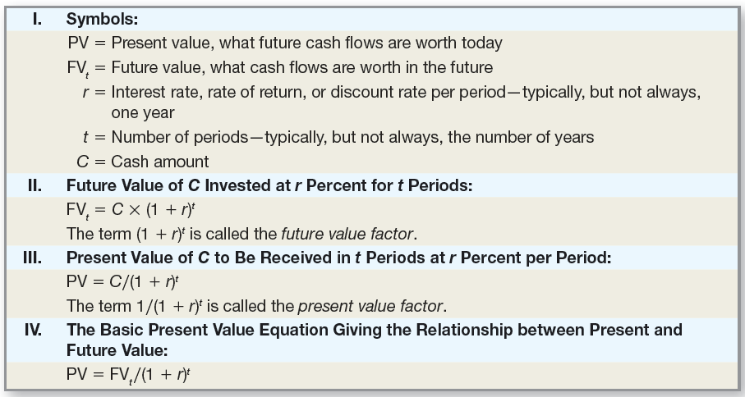
Finance Formulas

Slide 69
Comprehensive Problem
You have $10,000 to invest for five years.
How much additional interest will you earn if the investment provides a 5% annual return, when compared to a 4.5% annual return?
How long will it take your $10,000 to double in value if it earns 5% annually?
What annual rate has been earned if $1,000 grows into $4,000 in 20 years?
Notes:
N = 5
PV = -10,000
At I/Y = 5, the FV = 12,762.82
At I/Y = 4.5, the FV = 12,461.82
The difference is attributable to interest. That difference is 12,762.82 – 12,461.82 = 301
Calculator: To double the 10,000:
I/Y = 5
PV = -10,000
FV = 20,000
CPT N = 14.2 years
Note, the rule of 72 indicates 72/5 = 14 years, approximately.
N = 20
PV = -1,000
FV = 4,000
CPT I/Y = 7.18%
Formula: Ln(20,000/10,000) / ln(1.05) = 14.2 years

Slide 70
Terminology
Future Value
Present Value
Compounding
Discounting
Simple Interest
Compound Interest
Discount Rate
Required Rate of Return

Slide 71
Formulas
FV = PV(1 + r)^{t}
PV = FV / (1 + r)^{t}
r = (FV / PV)^{1/t} – 1
t = ln(FV / PV) / ln(1 + r)

Slide 72

Key Concepts and Skills
Compute the future value
of an investment made today
Compute the present value
of an investment made in the future
Compute the return on an investment and the number of time periods associated with an investment

Slide 73

What are the most important topics of this chapter?
Time changes the value of money as money can be invested.
2. Money in the future is worth more than money received today.
3. Money received in the future is worth less today.

Slide 74

What are the most important topics of this chapter?
The interest rate (or discount rate) and time determine the change in value of an investment.
5. The longer money is invested, the more compounding will increase the future value.

Slide 75
Questions?

