Slide 1

Chapter 6
Discounted Cash Flow Valuation
McGraw-Hill/Irwin
Copyright © 2013 by The McGraw-Hill Companies, Inc. All rights reserved.
Notes:
Notes to the Instructor:
The PowerPoints are designed for an introductory finance class for undergraduates with the emphasis on the key points of each chapter
Each chapter’s PowerPoint is designed for active learning by the students in your classroom
Not everything in the book’s chapter is necessarily duplicated on the PowerPoint slides
There are two finance calculators used (when relevant). You can delete the slides if you don’t use both TI and HP business calculators
Animation is used extensively. You can speed up, slow down or eliminate the animation at your discretion. To do so just open a chapter PowerPoint and go to any slide you want to modify; click on “Animations” on the top of your PowerPoint screen tools; then click on “Custom Animations”. A set of options will appear on the right of your screen. You can “change” or “remove” any line of that particular slide using the icon on the top of the page. The speed is one of the three options on every animation under “timing”.
Effort has been made to maintain the basic “7x7” rule of good PowerPoint presentations.
Additional problems and/or examples are available on McGraw-Hill’s Connect.
Previous PowerPoint decks included one for “calculators” and one for “formulas”. This deck combines the two into one presentation. The note section of each slide contains both the formulas and the calculator solutions.

Slide 2
Chapter Outline
Multiple Cash Flows: Future and Present Values
Multiple Equal Cash Flows: Annuities and Perpetuities
Comparing Rates: the Effect of Compounding
Loan Types
Loan Amortization

Slide 3
Chapter Outline
Multiple Cash Flows: Future and Present Values
Multiple Equal Cash Flows: Annuities and Perpetuities
Comparing Rates: the Effect of Compounding
Loan Types
Loan Amortization

Slide 4
Single Cash Flows
In the previous chapter, we used single cash flows and moved them forward and backward in time.
Today
1
2
3
4
5
PV
Compounding
FV
Today
1
2
3
4
5
PV
Discounting
FV

Slide 5

Multiple Cash Flows
What if we have more than one cash flow?
The concept (and formula) are identical if we simply look at the problem as a series of single payments.

Slide 6
Multiple Cash Flows Future Value 1
Suppose you have $1,000 now in a savings account that is earning 6%. You want to add $500 one year from now and $700 two years from now.
How much will you have two years from now in your savings account (after you make your $700 deposit)?
Today
1 Year
2 Years
$1,000
?
$500
$700

Slide 7
Multiple Cash Flows Future Value 1
Simply look at each payment separately and move them through time as we did in the earlier chapter.
Today
1 Year
2 Years
$1,000
$ 500
$ 700
$1,124
Now just add them up
because they are all
adjusted to be in “year 3” value
$ 530
$2,354
Notes:
It is important to point out that the last deposit of $700 was NOT adjusted in time as it already is in the time period we want: 2 years.
The idea of adding money up in the identical time frame is critical to the understanding of the time value of money. We cannot simply add up the $1,000 + $500 + $700 because they are in different time periods.
The future value of the $1,000 original deposit is actually $1,123.60 but it was rounded up to the nearest dollar for visual simplicity.

Slide 8
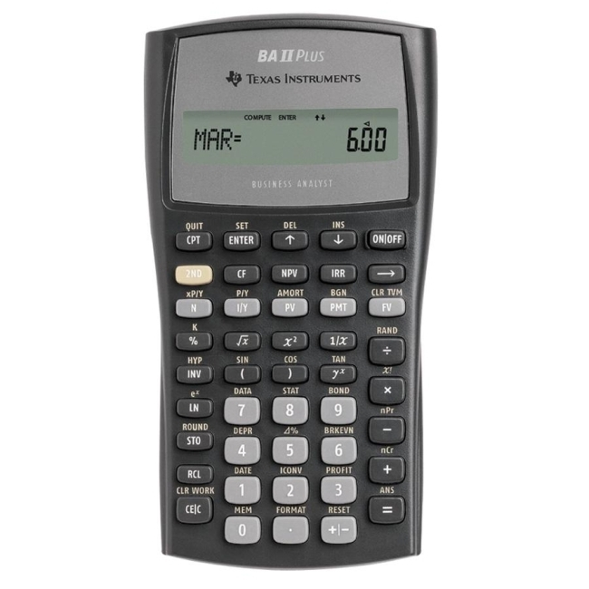
TI BA II Plus
2 years = N
1123.60
6% = I/Y
-$1,000 = PV
1st
CPT
? = FV
2nd
Notes:
This demonstration is a refresher of how to use the calculator, taking the $1,000 today and computing its future value at time 2.
Students should be capable of computing the future value of the $500 payment on their own.

Slide 9
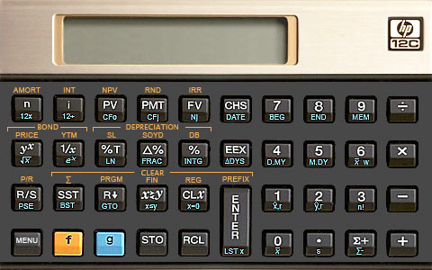
2 years = N
HP 12-C
6% = i
-$1,000 = PV
? = FV
1123.60
Notes:
This demonstration is a refresher of how to use the calculator, taking the $1,000 today and computing its future value at time 2.
Students should be capable of computing the future value of the $500 payment on their own.

Slide 10
Multiple Cash Flows Future Value 1B
Could we do this problem another way?
Bring each of the cash flows forward one year at a time and add them up each year.
Today
1 Year
2 Years
$1,000
$ 500
$ 700
$1,060
$1,560
$1,654
$2,354
Notes:
It is important to point out that the last deposit of $700 was NOT adjusted in time as it already is in the time period we want: 2 years.
The idea of adding money up in the identical time frame is critical to the understanding of the time value of money. We cannot simply add up the $1,000 + $500 + $700 because they are in different time periods.
The future value of the $1,560 year one total is actually $1,653.60 but it was rounded up to the nearest dollar for visual simplicity.

Slide 11
Multiple Cash Flows Future Value 1C
Let’s add one more twist to the problem:
What would be the value at year 5 if we made no further deposits into our savings account?
Today
1
2
3
4
5
?
$1,000
500
700

Slide 12
Multiple Cash Flows Future Value 1C
We could do this two different ways:
1. Bring the “year two” figure we previously produced to year five
Today
1
2
3
4
5
$1,000
500
700
?
$2,354
$2,803

Slide 13
Multiple Cash Flows Future Value 1C
We could do this two different ways:
2. Bring each of the three original dollars to year 5 and add them all up.
Today
1
2
3
4
5
$1,338
$1,000
500
700
?
$ 631
$ 833
$2,803
Notes:
With rounding up to dollars, we achieve the identical answer.

Slide 14
Multiple Cash Flows Present Value
To compute the present value of multiple cash flows, we again just bring the payments into the present value – one year at a time.

Slide 15
Multiple Cash Flows Present Value - 1
Consider receiving the following cash flows:
Year 1 CF = $200
Year 2 CF = $400
Year 3 CF = $600
Year 4 CF = $800
If the discount rate is 12%, what would this cash flow be worth today?

Slide 16
Multiple Cash Flows Present Value - 1
Visually, the time line
would look like this:
Today
1
2
3
4
?
200
400
600
800

Slide 17
Multiple Cash Flows Present Value - 1
To compute the present value of this future stream of cash, we just take each year to the present, one at a time:
Today
1
2
3
4
?
178.57
200
400
600
800
318.88
427.07
508.41
1,432.93

Slide 18
Multiple Cash Flows Present Value -1
Using a calculator, find the PV of each cash flow and just add them up!
Year 1 CF: N = 1; I/Y = 12; FV = 200; CPT PV = -178.57
Year 2 CF: N = 2; I/Y = 12; FV = 400; CPT PV = -318.88
Year 3 CF: N = 3; I/Y = 12; FV = 600; CPT PV = -427.07
Year 4 CF: N = 4; I/Y = 12; FV = 800; CPT PV = - 508.41
Total PV = 178.57 + 318.88 + 427.07 + 508.41 = $1,432.93
Notes:
The students can read the example in the book.
You are offered an investment that will pay you $200 in one year, $400 the next year, $600 the next year and $800 at the end of the next year. You can earn 12 percent on very similar investments. What is the most you should pay for this one?
Point out that the question could also be phrased as “How much is this investment worth?”
Remember the sign convention. The negative numbers imply that we would have to pay 1,432.93 today to receive the cash flows in the future.
Formula:
Year 1 CF: 200 / (1.12)¹ = 178.57
Year 2 CF: 400 / (1.12)² = 318.88
Year 3 CF: 600 / (1.12)³ = 427.07
Year 4 CF: 800 / (1.12)⁴ = 508.41
Calculator:
Year 1 CF: N = 1; I/Y = 12; FV = 200; CPT PV = -178.57
Year 2 CF: N = 2; I/Y = 12; FV = 400; CPT PV = -318.88
Year 3 CF: N = 3; I/Y = 12; FV = 600; CPT PV = -427.07
Year 4 CF: N = 4; I/Y = 12; FV = 800; CPT PV = - 508.41
Total PV = 178.57 + 318.88 + 427.07 + 508.41 = 1,432.93

Slide 19
Multiple Cash Flows Using a Spreadsheet
You can use the PV or FV functions in Excel to find the present value or future value of a set of cash flows
Setting the data up is half the battle – if it is set up properly, then you can just copy the formulas
Click on the Excel icon for an example
Notes:
Click on the tabs at the bottom of the worksheet to move from a future value example to a present value example.
Lecture Tip: The present value of a series of cash flows depends heavily on the choice of discount rate. You can easily illustrate this dependence in the spreadsheet on Slide 6.9 by changing the cell that contains the discount rate. A separate worksheet on the slide provides a graph of the relationship between PV and the discount rate.

Slide 20
Multiple Cash Flows Present Value - 2
You are considering an investment that will pay you $1,000 in one year, $2,000 in two years and $3,000 in three years. If you want to earn 10% on your money, how much would you be willing to pay?
N = 1; I/Y = 10; FV = 1,000; CPT PV = -909.09
N = 2; I/Y = 10; FV = 2,000; CPT PV = -1,652.89
N = 3; I/Y = 10; FV = 3,000; CPT PV = -2,253.94
PV = 909.09 + 1,652.89 + 2,253.94 = 4,815.93
Notes:
Formula:
PV = 1000 / (1.1)¹ = 909.09
PV = 2000 / (1.1)² = 1,652.89
PV = 3000 / (1.1)³ = 2,253.94
Calculator:
N = 1; I/Y = 10; FV = 1000; CPT PV = -909.09
N = 2; I/Y = 10; FV = 2000; CPT PV = -1,652.89
N = 3; I/Y = 10; FV = 3000; CPT PV = -2,253.94

Slide 21
Multiple Uneven Cash Flows Using the TI BA II + Calculator
Another way to use the financial calculator for uneven cash flows is to use the cash flow keys
Press CF and enter the cash flows beginning with year 0.
You have to press the “Enter” key for each cash flow
Use the down arrow key to move to the next cash flow
The “F” is the number of times a given cash flow occurs in consecutive periods
Use the NPV key to compute the present value by entering the interest rate for I, press “Enter”, then the down arrow, and then “CPT” computing the answer
Clear the cash flow worksheet by pressing CF and then 2nd CLR Work
Notes:
The next example will be worked using the cash flow keys.
Note that with the BA-II Plus, the students can double check the numbers they have entered by pressing the up and down arrows. It is similar to entering the cash flows into spreadsheet cells.
Other calculators also have cash flow keys. You enter the information by putting in the cash flow and then pressing CF. You have to always start with the year 0 cash flow, even if it is zero.
Remind the students that the cash flows have to occur at even intervals, so if you skip a year, you still have to enter a 0 cash flow for that year.

Slide 22
Decisions, Decisions
Your broker calls you and tells you that he has this great investment opportunity. If you invest $100 today, you will receive $40 in one year and $75 in two years. If you require a 15% return on investments of this risk, should you take the investment?
Use the CF keys to compute the present value of the proposed investment’s cash flows
CF; CF₀ = 0; C01 = 40; F01 = 1; C02 = 75; F02 = 1
NPV; I = 15; CPT NPV = $91.49
No! – the broker is charging more than you would be willing to pay ($100 versus the PV of $91.49)
Notes:
You can also use this as an introduction to NPV by having the students put –100 in for CF₀. When they compute the NPV, they will get –8.51. You can then discuss the NPV rule and point out that a negative NPV means that you do not earn your required return. You should also remind them that the sign convention on the regular TVM keys is NOT the same as getting a negative NPV.

Slide 23
TI BA II Plus
CF
91.49
0 = CF₀ ; ↓
40 = CO1; ↓
1 = FO1; ↓
75 = CO2; ↓
1 = FO2; ↓
NPV
15 = I/Y
1st
↓
2nd
CPT
6-23
Notes:
You must use the down arrow key (↓) to move to the next cash flow.
If student’s use -$100 for CF₀, then they will obtain the NPV as the answer and not the PV of the cash flows. NPV will be discussed in detail in a later chapter with calculator examples presented.

Slide 24
Multiple Uneven Cash Flows Using the HP 12c Calculator
Another way to use the financial calculator for uneven cash flows is to use the cash flow keys
CF = 0 and then press “g” + CF₀.
Enter each cash flow separately followed by “g” + CF_{j}
Enter the interest rate and press the “i” key.
To obtain the NPV, press “f” + NPV keys
Clear the cash flow worksheet by pressing “f” and then CLX
Notes:
To use the identical procedure for computing the NPV (instead of the PV of the unequal cash flows), simply put the cost of the investment (as a negative number) in step one for CF = -cost. Students who try this for this problem, entering -$100 will get a NPV of -8.51.

Slide 25
Decisions, Decisions
Your broker calls you and tells you that he has this great investment opportunity. If you invest $100 today, you will receive $40 in one year and $75 in two years. If you require a 15% return on investments of this risk, should you take the investment?
Use the CF keys to compute the present value of the proposed investment’s cash flows
“g” CF₀ = 0; “g” CF_{j} = 40; “g” CF_{j} = 75
i = 15; “f” NPV = 91.49
No! – the broker is charging more than you would be willing to pay ($100 versus the PV of $91.49)
Notes:
You can also use this as an introduction to NPV by having the students put –100 in for CF₀. When they compute the NPV, they will get –8.51. You can then discuss the NPV rule and point out that a negative NPV means that you do not earn your required return. You should also remind them that the sign convention on the regular TVM keys is NOT the same as getting a negative NPV.

Slide 26
0 = CF₀
HP 12-C
40 = CF_{j}
75 = CF_{j}
15% = i
? = NPV
91.49
Notes:
This demonstration is a refresher of how to use the calculator, taking the $1,000 today and computing its future value at time 2.
If student’s use -$100 for CF₀, then they will obtain the NPV as the answer and not the PV of the cash flows. NPV will be discussed in detail in a later chapter with calculator examples presented.

Slide 27
Quick Quiz I
Suppose you are looking at the following possible cash flows: Year 1 CF = $100; Years 2 and 3 CFs = $200; Years 4 and 5 CFs = $300. The required discount rate is 7%.
What is the value of the cash flows
at year 5?
What is the value of the cash flows today?
What is the value of the cash flows
at year 3?
Notes:
The easiest way to work this problem is to use the uneven cash flow keys and find the present value first and then compute the others based on that.
CF₀ = 0; C01 = 100; F01 = 1; C02 = 200; F02 = 2; C03 = 300; F03 = 2; I = 7; CPT NPV = 874.17
Value in year 5: PV = 874.17; N = 5; I/Y = 7; CPT FV = 1,226.07
Value in year 3: PV = 874.17; N = 3; I/Y = 7; CPT FV = 1,070.90
Using formulas and one CF at a time:
Year 1 CF: FV₅ = 100(1.07)⁴ = 131.08; PV₀ = 100 / 1.07 = 93.46; FV₃ = 100(1.07)² = 114.49
Year 2 CF: FV₅ = 200(1.07)³ = 245.01; PV₀ = 200 / (1.07)² = 174.69; FV₃ = 200(1.07) = 214
Year 3 CF: FV₅ = 200(1.07)² = 228.98; PV₀ = 200 / (1.07)³ = 163.26; FV₃ = 200
Year 4 CF: FV₅ = 300(1.07) = 321; PV₀ = 300 / (1.07)⁴ = 228.87; PV₃ = 300 / 1.07 = 280.37
Year 5 CF: FV₅ = 300; PV₀ = 300 / (1.07)⁵ = 213.90; PV₃ = 300 / (1.07)² = 262.03
Value at year 5 = 131.08 + 245.01 + 228.98 + 321 + 300 = 1,226.07
Present value today = 93.46 + 174.69 + 163.26 + 228.87 + 213.90 = 874.18 (difference due to rounding)
Value at year 3 = 114.49 + 214 + 200 + 280.37 + 262.03 = 1,070.89

Slide 28
Chapter Outline
Multiple Cash Flows: Future and Present Values
Multiple Equal Cash Flows: Annuities and Perpetuities
Comparing Rates: the Effect of Compounding
Loan Types
Loan Amortization

Slide 29
Annuities and Perpetuities Definitions
Annuity – finite series of equal payments that occur at regular intervals
If the first payment occurs at the end of the period, it is called an ordinary annuity
If the first payment occurs at the beginning of the period, it is called an annuity due
Perpetuity – infinite series of equal payments

Slide 30
Annuities and Perpetuities Basic Formulas
Perpetuity: PV = C / r
Annuity:
Notes:
Lecture Tip: The annuity factor approach is a short-cut approach in the process of calculating the present value of multiple cash flows and that it is only applicable to a finite series of level cash flows. Financial calculators have reduced the need for annuity factors, but it may still be useful from a conceptual standpoint to show that the PVIFA is just the sum of the PVIFs across the same time period.

Slide 31
Annuities on the Spreadsheet - Example
The present value and future value formulas in a spreadsheet include a place for annuity payments
Click on the Excel icon to see an example

Slide 32
Annuities and the Calculator
You can use the PMT key on the calculator for equal payments
Notes:
Other calculators also have a key that allows you to switch between Beg/End.

Slide 33
Annuities and the Calculator
Ordinary annuity versus annuity due
TI BA II Plus: You can switch your calculator between the two types by using the 2nd BGN 2nd Set on the TI BA-II Plus
HP 12C: “g” 7 sets the calculator for Beginning and “g” 8 for End.
If you see “BGN” or “Begin” in the display of your calculator, you have it set for an annuity due
Most problems are
ordinary annuities
Notes:
Other calculators also have a key that allows you to switch between Beg/End.
(The sign convention still holds)

Slide 34
Annuity: Saving for a Car
After carefully going over your budget, you have determined you can afford to pay $632 per month towards a new sports car. You call up your local bank and find out that the going rate is 1 percent per month for 48 months. How much can you borrow?
Notes:
The students can read the example in the book.
Note that the difference between the answer here and the one in the book is due to the rounding of the Annuity PV factor in the book.

Slide 35
Annuity: Saving for a Car
You borrow money TODAY so you need to compute the present value.
48 N; 1 I/Y; -632 PMT; CPT PV = 23,999.54 ($24,000)
Formula:
Notes:
The students can read the example in the book.
After carefully going over your budget, you have determined you can afford to pay $632 per month towards a new sports car. You call up your local bank and find out that the going rate is 1 percent per month for 48 months. How much can you borrow?
Note that the difference between the answer here and the one in the book is due to the rounding of the Annuity PV factor in the book.

Slide 36
Annuity: Sweepstakes Winner
Suppose you win the Publishers Clearinghouse $10 million sweepstakes. The money is paid in equal annual end-of-year installments of $333,333.33 over 30 years.
If the appropriate discount rate is 5%, how much is the sweepstakes actually worth today?
Notes:
Calculator: 30 N; 5 I/Y; 333,333.33 PMT; CPT PV = 5,124,150.29
Formula:
PV = 333,333.33[1 – 1/1.05³⁰] / .05 = 5,124,150.29

Slide 37

Saving For Retirement
You are offered the opportunity to put some money away for retirement. You will receive five annual payments of $25,000 each, beginning in 40 years.
How much would you be willing to invest today if you desire an interest rate of 12%?

Slide 38
Saving For Retirement Timeline
0 1 2 … 39 40 41 42 43 44
0 0 0 … 0 25K 25K 25K 25K 25K
Notes:
Use cash flow keys for the TI BA II +:
CF; CF₀ = 0; C01 = 0; F01 = 39; C02 = 25,000; F02 = 5; NPV; I = 12; CPT NPV = 1,084.71
Use the cash flow keys for the HP 12C:
“g” CF0 = 0; “g” Nj = 40; “g” CFj = 25,000; “g” CFj = 25,000; “g” CFj = 25,000; “g” CFj = 25,000; “g” CFj = 25,000; I = 12; “f” NPV = 1,084.71.
The HP and the TI approach annuities slightly differently, which can be a cause for problems if both calculator types are used.

Slide 39
Annuity: Buying a House
You are ready to buy a house, and you have $20,000 for a down payment and closing costs. Closing costs are estimated to be 4% of the loan value. You have an annual salary of $36,000, and the bank is willing to allow your monthly mortgage payment to be equal to 28% of your monthly income.
Notes:
It might be good to note that the outstanding balance on the loan at any point in time is simply the present value of the remaining payments.

Slide 40
Annuity: Buying a House (Continued)
The interest rate on the loan is 6% per year with monthly compounding (.5% per month) for a 30-year fixed rate loan.
How much money will the bank loan you?
How much can you offer for the house?
Notes:
It might be good to note that the outstanding balance on the loan at any point in time is simply the present value of the remaining payments.

Slide 41
Annuity: Buying a House - Continued
Bank loan
Monthly income = 36,000 / 12 = 3,000
Maximum payment = .28(3,000) = 840
30*12 = 360 N
.5 I/Y
-840 PMT
CPT PV = $140,105
Total Price
Closing costs = .04(140,105) = 5,604
Down payment = 20,000 – 5,604 = 14,396
Total Price = 140,105 + 14,396 = $154,501
Notes:
You might point out that you would probably not offer 154,501. The more likely scenario would be 154,500 , or less if you assumed negotiations would occur.
Formula
PV = 840[1 – 1/1.005³⁶⁰] / .005 = 140,105
Calculator:
30*12 = 360 N
.5 I/Y
840 PMT
CPT PV = 140,105

Slide 42
Quick Quiz II
You know the payment amount for a loan, and you want to know how much was borrowed. Do you compute a present value or a future value?
You want to receive 5,000 per month in retirement. If you can earn 0.75% per month and you expect to need the income for 25 years, how much do you need to have in your account at retirement?
Notes:
Calculator
PMT = 5,000; N = 25*12 = 300; I/Y = .75; CPT PV = 595,808
Formula
PV = 5000[1 – 1 / 1.0075³⁰⁰] / .0075 = 595,808

Slide 43
Finding the Payment
Suppose you want to borrow $20,000 for a new car. You can borrow at 8% per year, compounded monthly
(8/12 = .66667% per month).
If you take a 4-year loan, what is your monthly payment?
4(12) = 48 N; 20,000 PV; .66667 I/Y;
CPT PMT = $488.26
Notes:
Note if you do not round the monthly rate and actually use 8/12, then the payment will be 448.30
Formula
20,000 = PMT[1 – 1 / 1.0066667⁴⁸] / .0066667
PMT = 488.26
Calculator:
4(12) = 48 N; 20,000 PV; .66667 I/Y; CPT PMT = 488.26

Slide 44
Finding the Payment on a Spreadsheet
Another TVM formula that can be found in a spreadsheet is the payment formula:
PMT(rate,nper,pv,fv)
(The same sign convention holds as for the PV and FV formulas)
Click on the Excel icon for an
example

Slide 45
Finding the Number of Payments I
You ran a little short on your spring break vacation, so you put $1,000 on your credit card. You can only afford to make the minimum payment of $20 per month. The interest rate on the credit card is 1.5 percent per month.
How long will you need to pay off the $1,000?
Notes:
This is an excellent opportunity to talk about credit card debt and the problems that can develop if it is not handled properly. Many students don’t understand how it works, and it is rarely discussed. This is something that students can take away from the class, even if they aren’t finance majors.

Slide 46
Finding the Number of Payments I
The sign convention matters!
1.5 I/Y
1,000 PV
-20 PMT
CPT N = 93.111 MONTHS = 7.75 years
And this is only if you don’t charge anything more on the card!
Notes:
Formula:
1000 = 20(1 – 1/1.015^{t}) / .015
.75 = 1 – 1 / 1.015^{t}
1 / 1.015^{t} = .25
1 / .25 = 1.015^{t}
t = ln(1/.25) / ln(1.015) = 93.111 months = 7.75 years
Calculator:
1.5 I/Y
1,000 PV
-20 PMT
CPT N = 93.111 MONTHS = 7.75 years

Slide 47
Finding the Number of Payments II
Suppose you borrow $2,000 at 5%, and you are going to make annual payments of $734.42.
How long before you pay off the loan?
(the sign convention matters!)
5 I/Y
2,000 PV
-734.42 PMT
CPT N = 3 years
Notes:
Formula:
2000 = 734.42(1 – 1/1.05^{t}) / .05
.136161869 = 1 – 1/1.05^{t}
1/1.05^{t} = .863838131
1.157624287 = 1.05^{t}
t = ln(1.157624287) / ln(1.05) = 3 years
Calculator:
Sign convention matters!!!
5 I/Y
2,000 PV
-734.42 PMT
CPT N = 3 years

Slide 48
Chapter Outline
Multiple Cash Flows: Future and Present Values
Multiple Equal Cash Flows: Annuities and Perpetuities
Comparing Rates: the Effect of Compounding
Loan Types
Loan Amortization

Slide 49
Finding the Rate
Suppose you borrow $25,000 from your parents to buy a car. You agree to pay $207.58 per month for 60 months.
What is the monthly interest rate?
(The sign convention matters!)
60 N
25,000 PV
-207.58 PMT
CPT I/Y = 2.05%
Notes:
The next slide talks about how to do this without a financial calculator.

Slide 50
Annuity – Finding the Rate Without a Financial Calculator
Trial and Error Process (ugh!)
Choose an interest rate and compute the PV of the payments based on this rate
Compare the computed PV with the actual loan amount
If the computed PV > loan amount, then the interest rate is too low
If the computed PV < loan amount, then the interest rate is too high
Adjust the rate and repeat the process until the computed PV and the loan amount are equal

Slide 51
Quick Quiz III
You want to receive $5,000 per month for the next 5 years. How much would you need to deposit today if you can earn 0.75% per month?
What monthly rate would you need to earn if you only have $200,000 to deposit?
Suppose you have $200,000 to deposit and can earn 0.75% per month.
How many months could you receive the $5,000 payment?
How much could you receive every month for 5 years?
Notes:
Q1: 5(12) = 60 N; .75 I/Y; 5000 PMT; CPT PV = -240,867
PV = 5000(1 – 1 / 1.0075⁶⁰) / .0075 = 240,867
Q2: -200,000 PV; 60 N; 5000 PMT; CPT I/Y = 1.439%
Trial and error without calculator
Q3: -200,000 PV; .75 I/Y; 5000 PMT; CPT N = 47.73 (47 months plus partial payment in month 48)
200,000 = 5000(1 – 1 / 1.0075^{t}) / .0075
.3 = 1 – 1/1.0075^{t}
1.0075^{t} = 1.428571429 t = ln(1.428571429) / ln(1.0075) = 47.73 months
Q4: -200,000 PV; 60 N; .75 I/Y; CPT PMT = 4151.67
200,000 = C(1 – 1/1.0075⁶⁰) / .0075
C = 4151.67

Slide 52
Future Values for Annuities
Suppose you begin saving for your retirement by depositing $2,000 per year in an IRA. If the interest rate is 7.5%, how much will you have in 40 years?
(Remember the sign convention!)
40 N
7.5 I/Y
-2,000 PMT
CPT FV = $454,513.04
Notes:
Formula:
FV = 2000(1.075⁴⁰ – 1)/.075 = 454,513.04
Calculator:
Remember the sign convention!!!
40 N
7.5 I/Y
-2,000 PMT
CPT FV = 454,513.04
Lecture Tip: It should be emphasized that annuity factor tables (and the annuity factors in the formulas) assumes that the first payment occurs one period from the present, with the final payment at the end of the annuity’s life. If the first payment occurs at the beginning of the period, then FV’s have one additional period for compounding and PV’s have one less period to be discounted. Consequently, you can multiply both the future value and the present value by (1 + r) to account for the change in timing.

Slide 53
Annuity Due
You are saving for a new house and you need 20% down to get a loan. You put $10,000 per year in an account paying 8%. The first payment is made today.
How much will you have at the end of 3 years
(you make a total of three $10,000 payments)?
2nd BGN 2nd Set (you should see BGN in the display)
3 N
-10,000 PMT
8 I/Y
CPT FV = $35,061.12
(“2nd BGN 2nd Set” needs to be changed back to an ordinary annuity when you are finished)
Notes:
Note that the procedure for changing the calculator to an annuity due is similar on other calculators.
Formula:
FV = 10,000[(1.08³ – 1) / .08](1.08) = 35,061.12
Calculator:
2nd BGN 2nd Set (you should see BGN in the display)
3 N
-10,000 PMT
8 I/Y
CPT FV = 35,061.12
2nd BGN 2nd Set (be sure to change it back to an ordinary annuity)
What if it were an ordinary annuity? FV = 32,464 (so you receive an additional 2,597.12 by starting to save today.)

Slide 54
Annuity Due Timeline
0 1 2 3
10000 10000 10000
32,464
35,016.12
Notes:
If you use the regular annuity formula, the FV will occur at the same time as the last payment. To get the value at the end of the third period, you have to take it forward one more period.

Slide 55
Perpetuity
Perpetuity formula: PV = C / r
Current required return:
40 = 1 / r
r = .025 or 2.5% per quarter
Dividend for new preferred:
100 = C / .025
C = 2.50 per quarter
Notes:
This is a good preview to the valuation issues discussed in future chapters. The price of an investment is just the present value of expected future cash flows.
Example statement:
Suppose the Fellini Co. wants to sell preferred stock at $100 per share. A very similar issue of preferred stock already outstanding has a price of $40 per share and offers a dividend of $1 every quarter. What dividend will Fellini have to offer if the preferred stock is going to sell?

Slide 56
Perpetuity Example
Suppose the Fellini Company wants to sell preferred stock at $100 per share. A similar issue of preferred stock already outstanding has a price of $40 per share and offers a dividend of $1 every quarter.
What dividend will Fellini have to offer if the preferred stock is going to sell?

Slide 57
Quick Quiz IV
You want to have $1 million to use for retirement in 35 years. If you can earn 1% per month, how much do you need to deposit on a monthly basis if the first payment is made in one month?
What if the first payment is made today?
You are considering preferred stock that pays a quarterly dividend of $1.50. If your desired return is 3% per quarter, how much would you be willing to pay?
Notes:
Q1: 35(12) = 420 N; 1,000,000 FV; 1 I/Y; CPT PMT = 155.50
1,000,000 = C (1.01⁴²⁰ – 1) / .01
C = 155.50
Q2: The payments would be smaller by one period’s interest. Divide the above result by 1.01.
1,000,000 = C[(1.01⁴²⁰ – 1) / .01] ( 1.01)
C = 153.96
Q3: PV = 1.50 / .03 = $50

Slide 58
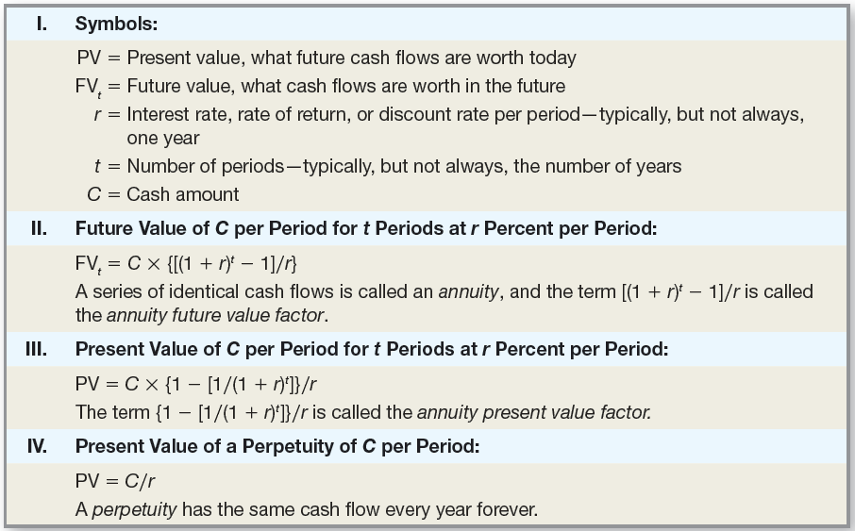
Terms and Formulas

Slide 59
Effective Annual Rate (EAR)
This is the actual rate paid (or received) after accounting for compounding that occurs during the year
If you want to compare two alternative investments with different compounding periods, you need to compute the EAR and use that for comparison.

Slide 60

Annual Percentage Rate (APR)
This is the annual rate that is quoted by law on all loans.
By definition: APR = period rate times the number of periods per year
Notes:
The APR must be the largest font (of interest rates) when used in a contract as required by the US federal “truth in lending” laws.

Slide 61
Annual Percentage Rate (APR)
Consequently, to get the period rate we rearrange the APR equation:
Period rate = APR / number of periods per year
You should NEVER divide the effective rate by the number of periods per year – it will NOT give you the period rate
Notes:
The APR must be the largest font (of interest rates) when used in a contract as required by the US federal “truth in lending” laws.

Slide 62
Computing APRs
What is the APR if the monthly rate is .5%?
.5(12) = 6%
What is the APR if the semiannual rate is .5%?
.5(2) = 1%
What is the monthly rate if the APR is 12% with monthly compounding?
12 / 12 = 1%

Slide 63

Things to Remember
You ALWAYS need to make sure that the interest rate and the time period match.
If you are looking at annual periods, you need an annual rate.
If you are looking at monthly periods, you need a monthly rate.

Slide 64
Things to Remember
If you have an APR based on monthly compounding, you have to use monthly periods for lump sums, or adjust the interest rate appropriately if you have payments other than monthly

Slide 65
Computing EARs Example
Suppose you can earn 1% per month on $1 invested today.
What is the APR?
1(12) = 12%
How much are you effectively earning?
FV = 1(1.01)¹² = 1.1268
Rate = (1.1268 – 1) / 1
= .1268 = 12.68%

Slide 66
Computing EARs Example (continued)
Suppose you put it in another account and earn 3% per quarter.
What is the APR?
3(4) = 12%
How much are you effectively earning?
FV = 1(1.03)⁴ = 1.1255
Rate = (1.1255 – 1) / 1
= .1255 = 12.55%
Notes:
Point out that the APR is the same in either case, but your effective rate is different. Ask them which account they should use.

Slide 67
EAR - Formula
Remember that the APR is the quoted rate, and
“m” is the number of compounding periods per year
Notes:
Using the calculator:
The TI BA-II Plus has an I conversion key that allows for easy conversion between quoted rates and effective rates.
2nd I Conv NOM is the quoted rate; down arrow EFF is the effective rate; down arrow C/Y is compounding periods per year. You can compute either the NOM or the EFF by entering the other two pieces of information, then going to the one you wish to compute and pressing CPT.

Slide 68
Decisions, Decisions II
You are looking at two savings accounts. One pays 5.25%, with daily compounding. The other pays 5.3% with semiannual compounding.
Which account should you use?
First account:
EAR = (1 + .0525/365)³⁶⁵ – 1 = 5.39%
Second account:
EAR = (1 + .053/2)² – 1 = 5.37%
Which account should you choose and why?
Notes:
Remind students that rates are quoted on an annual basis. The given numbers are APRs, not daily or semiannual rates.
Calculator:
2nd I conv 5.25 NOM Enter up arrow 365 C/Y Enter up arrow CPT EFF = 5.39%
5.3 NOM Enter up arrow 2 C/Y Enter up arrow CPT EFF = 5.37%

Slide 69
Decisions, Decisions II Continued
Let’s verify the choice. Suppose you invest $100 in each account. How much will you have in each account in one year?
First Account:
365 N; 5.25 / 365 = .014383562 I/Y; 100 PV;
CPT FV = $105.39
Second Account:
2 N; 5.3 / 2 = 2.65 I/Y; 100 PV; CPT FV = $105.37
You have more money in the first account.
Notes:
It is important to point out that the daily rate is NOT .014, it is .014383562
First Account:
365 N; 5.25 / 365 = .014383562 I/Y; 100 PV; CPT FV = 105.39
Second Account:
2 N; 5.3 / 2 = 2.65 I/Y; 100 PV; CPT FV = 105.37
Lecture Tip: Here is a way to drive the point of this section home. Ask how many students have taken out a car loan. Now ask one of them what annual interest rate s/he is paying on the loan. Students will typically quote the loan in terms of the APR. Point out that, since payments are made monthly, the effective rate is actually more than the rate s/he just quoted, and demonstrate the calculation of the EAR.

Slide 70
Computing APRs from EARs
If you have an effective rate, how can you compute the APR? Rearrange the EAR equation and you get:

Slide 71
APR - Example
Suppose you want to earn an effective rate of 12% and you are looking at an account that compounds on a monthly basis. What APR must they pay?
Notes:
On the calculator: 2nd I conv down arrow 12 EFF Enter down arrow 12 C/Y Enter down arrow CPT NOM

Slide 72
Computing Payments with APRs
Suppose you want to buy a new computer system and the store is willing to allow you to make monthly payments. The entire computer system costs $3,500. The loan period is for 2 years, and the interest rate is 16.9% with monthly compounding.
What is your monthly payment?
2(12) = 24 N; 16.9 / 12 = 1.408333333 I/Y; 3,500 PV; CPT PMT = -$172.88
Notes:
2(12) = 24 N; 16.9 / 12 = 1.408333333 I/Y; 3,500 PV; CPT PMT = -172.88
See the Lecture Tip in the IM for a discussion of situations that present a mismatch between the payment period and the compounding period.

Slide 73
Future Values with Monthly Compounding
Suppose you deposit $50 a month into an account that has an APR of 9%, based on monthly compounding.
How much will you have in the account in 35 years?
35(12) = 420 N
9 / 12 = .75 I/Y
50 PMT
CPT FV = $147,089.22
Notes:
Formula:
FV = 50[1.0075⁴²⁰ – 1] / .0075 = 147,089.22
Calculator:
35(12) = 420 N
9 / 12 = .75 I/Y
50 PMT
CPT FV = 147,089.22

Slide 74
Present Value with Daily Compounding
You need $15,000 in 3 years for a new car. If you can deposit money into an account that pays an APR of 5.5% based on daily compounding, how much would you need to deposit?
3(365) = 1,095 N
5.5 / 365 = .015068493 I/Y
15,000 FV
CPT PV = -$12,718.56
Notes:
Formula:
FV = 15,000 / (1.00015068493)¹⁰⁹⁵ = 12,718.56
Calculator:
3(365) = 1095 N
5.5 / 365 = .015068493 I/Y
15,000 FV
CPT PV = -12,718.56

Slide 75
Quick Quiz V
What is the definition of an APR?
What is the effective annual rate?
Which rate should you use to compare alternative investments or loans?
Which rate do you need to use in the time value of money calculations?
Notes:
APR = period rate * # of compounding periods per year
EAR is the rate we earn (or pay) after we account for compounding
We should use the EAR to compare alternatives
We need the period rate, and we have to use the APR to get it

Slide 76
Chapter Outline
Multiple Cash Flows: Future and Present Values
Multiple Equal Cash Flows: Annuities and Perpetuities
Comparing Rates: the Effect of Compounding
Loan Types
Loan Amortization

Slide 77
Types of Loans
Pure Discount Loan
Interest-only Loan
Amortized with Fixed Principal payment
Amortized with Fixed Payment

Slide 78
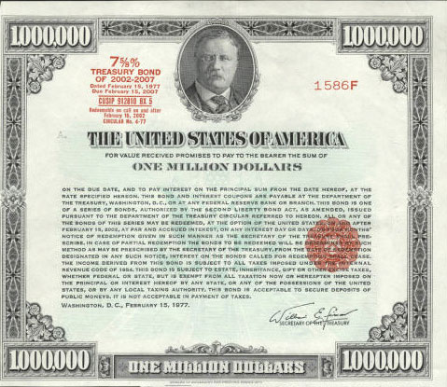
Pure Discount Loans
Treasury bills are excellent examples of pure discount loans. The principal amount is repaid at some future date, without any periodic interest payments.
Notes:
Remind students that the value of an investment is the present value of expected future cash flows.
Formula:
PV = 10,000 / 1.07 = 9345.79
Calculator:
1 N; 10,000 FV; 7 I/Y; CPT PV = -9,345.79

Slide 79
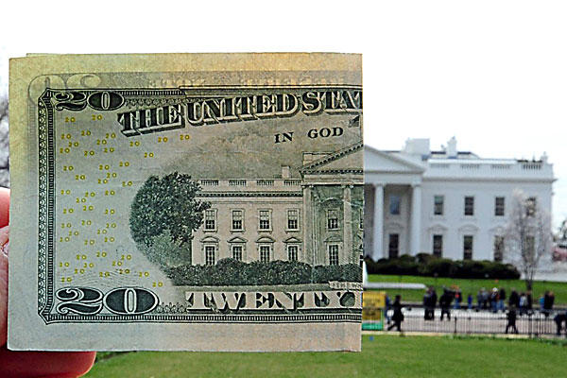
Pure Discount Loans
If a T-bill promises to repay $10,000 in 12 months and the market interest rate is 7 percent, how much will the bill sell for in the market?
1 N; 10,000 FV; 7 I/Y; CPT PV = -$9,345.79
Notes:
Remind students that the value of an investment is the present value of expected future cash flows.
Formula:
PV = 10,000 / 1.07 = 9345.79
Calculator:
1 N; 10,000 FV; 7 I/Y; CPT PV = -9,345.79

Slide 80
Chapter Outline
Multiple Cash Flows: Future and Present Values
Multiple Equal Cash Flows: Annuities and Perpetuities
Comparing Rates: the Effect of Compounding
Loan Types
Loan Amortization

Slide 81
Amortized Loan with Fixed Principal Payment - Example
Consider a $50,000, 10 year loan at 8% interest. The loan agreement requires the firm to pay $5,000 in principal each year plus interest for that year.
Click on the Excel icon to see the amortization table

Slide 82
Amortized Loan with Fixed Payment - Example
Each payment covers the interest expense plus
reduces principal
Consider a 4 year loan with annual payments. The interest rate is 8%, and the principal amount is $5,000.
What is the annual payment?
4 N
8 I/Y
5,000 PV
CPT PMT = -$1,509.60
Click on the Excel icon to see the amortization table
Notes:
Lecture Tip: Consider a $200,000, 30-year loan with monthly payments of $1330.60 (7% APR with monthly compounding). You would pay a total of $279,016 in interest over the life of the loan. Suppose instead, you cut the payment in half and pay $665.30 every two weeks (note that this entails paying an extra $1330.60 per year because there are 26 two week periods). You will cut your loan term to just under 24 years and save almost $70,000 in interest over the life of the loan. Calculations on TI-BAII plus First: PV = 200,000; N=360; I=7; P/Y=C/Y=12; CPT PMT = 1330.60 (interest = 1330.60*360 – 200,000) Second: PV = 200,000; PMT = -665.30; I = 7; P/Y = 26; C/Y = 12; CPT N = 614 payments / 26 = 23.65 years (interest = 665.30*614 – 200,000)

Slide 83
Comprehensive Problem Part 1
An investment will provide you with $100 at the end of each year for the next 10 years. What is the present value of that annuity if the discount rate is 8% annually?
What is the present value of the above if the payments are received at the beginning of each year?
Notes:
Present value problems:
End of the year: 10 N; 8 I/Y; 100 PMT; CPT PV = -671.01
Beginning of the year: PV = $671.00 X 1.08 = $724.69
Future value problems:
10 N; 8 I/Y; -100 PMT; CPT FV = 1,448.66
10N; 8 I/Y; -1,000 PV; -100 PMT; CPT FV = 3,607.58

Slide 84
Comprehensive Problem Part 2
If you deposit those payments into an account earning 8%, what will the future value be in 10 years?
What will the future value be if you open the account with $1,000 today, and then make the $100 deposits at the end of each year?
Notes:
Present value problems:
End of the year: 10 N; 8 I/Y; 100 PMT; CPT PV = -671.01
Beginning of the year: PV = $671.00 X 1.08 = $724.69
Future value problems:
10 N; 8 I/Y; -100 PMT; CPT FV = 1,448.66
10N; 8 I/Y; -1,000 PV; -100 PMT; CPT FV = 3,607.58

Slide 85
Terminology
Present value of multiple cash flows
Future value of multiple cash flows
Annuity
Annuity Due
Perpetuity
Effective Annual Rate (EAR)
Annual Percentage Rate (APR)
Continuous Compounding

Slide 86
Terminology
(continued)
Pure Discount Loan
Interest-only Loan
Amortized Loan with Fixed Principle
Amortized Loan with Fixed Payment

Slide 87
Formulas
Perpetuity: PV = C / r
Annuity:

Slide 88
Formulas
(continued)

Slide 89
Formulas
(continued)

Slide 90

Key Concepts and Skills
Compute the future value
of multiple cash flows
Compute the present value
of multiple cash flows
Distinguish between an ordinary annuity and an annuity due

Slide 91

Key Concepts and Skills
Compute loan payments
Find the interest rate
on a loan
Explain how interest rates are quoted
Give examples of different ways a loan can be paid off

Slide 92

What are the most important topics of this chapter?
Multiple cash flows are moved both forward in time and into present value just like single payments.
Annuities are a special case of multiple cash flows in that they are a “fixed, equal, uninterrupted series of payments or receipts”.

Slide 93

What are the most important topics of this chapter?
Effective Annual Rate and Annual Percent Rate are two methods to determine the cost of a loan.
Loans can be pure discount, interest-only, or amortized – with fixed principal or fixed payments.

Slide 94
Questions?

