Slide 1

Chapter 7
Interest Rates and Bond Valuation
McGraw-Hill/Irwin
Copyright © 2013 by The McGraw-Hill Companies, Inc. All rights reserved.
Notes:
Notes to the Instructor:
The PowerPoints are designed for an introductory finance class for undergraduates with the emphasis on the key points of each chapter
Each chapter’s PowerPoint is designed for active learning by the students in your classroom
Not everything in the book’s chapter is necessarily duplicated on the PowerPoint slides
There are two finance calculators used (when relevant). You can delete the slides if you don’t use both TI and HP business calculators
Animation is used extensively. You can speed up, slow down or eliminate the animation at your discretion. To do so just open a chapter PowerPoint and go to any slide you want to modify; click on “Animations” on the top of your PowerPoint screen tools; then click on “Custom Animations”. A set of options will appear on the right of your screen. You can “change” or “remove” any line of that particular slide using the icon on the top of the page. The speed is one of the three options on every animation under “timing”.
Effort has been made to maintain the basic “7x7” rule of good PowerPoint presentations.
Additional problems and/or examples are available on McGraw-Hill’s Connect.

Slide 2
Chapter Outline
Bond Definition
Bond Features
Valuation of a Bond
Bond Relationships
Inflation and Interest Rates
Determinants of Bond Yields
Bond Ratings
Bond Markets

Slide 3
Chapter Outline
Bond Definition
Bond Features
Valuation of a Bond
Bond Relationships
Inflation and Interest Rates
Determinants of Bond Yields
Bond Ratings
Bond Markets

Slide 4
What is a bond?

Slide 5
A bond is a contract between two parties: one is the investor (you) and the other is a company or a government agency (like a municipal bond)

Slide 6
Chapter Outline
Bond Definition
Bond Features
Valuation of a Bond
Bond Relationships
Inflation and Interest Rates
Determinants of Bond Yields
Bond Ratings
Bond Markets

Slide 7

You are the investor
The company (or government) is borrowing the money

Slide 8
A bond contains three key items:
The par value
(usually $1,000)
2. The length of time (often 10 or 20 years)
3. A coupon interest rate

Slide 9
You lend money to the borrower and you will get back your original investment plus interest.
The interest is determined by the coupon interest rate.

Slide 10
For example:
A 6% coupon interest rate yields:
(the coupon interest rate) x ( the par value)
(6%) x ($1,000) = $60 per year for each year of the bond.

Slide 11
Let’s look at this visually using the time line:
1
2
3
4
5
$60
$60
$60
$60
$60

Slide 12
Let’s look at this visually using the time line:
Now let’s add the maturity value…
1
2
3
4
5
$60
$60
$60
$60
$60
$1,000

Slide 13
So the investor receives the principle ($1,000) and earned interest ($60 per year) as payment for loaning the company money.

Slide 14
Types of Bonds
Government Bonds
Zero Coupon Bonds
Floating-Rate Bonds
Catastrophe (Cat) Bonds
Income Bonds
Convertible Bond
Put Bond
Sukuk
James Bond
Notes:
Sukuk is an Islamic bond which by Islamic law cannot charge interest. There are many possible structures to sukuk, such as partial ownership of a debt or an asset. Most sukuk are bought and held to maturity and as such, there is an extremely illiquid secondary market for sukuks.

Slide 15
Chapter Outline
Bond Definition
Bond Features
Valuation of a Bond
Bond Relationships
Inflation and Interest Rates
Determinants of Bond Yields
Bond Ratings
Bond Markets

Slide 16
Our task:
To Value a Bond

Slide 17
And how will we accomplish this task?

Slide 18
B
A
E
F
E
I
P
V
T
Bring
All
Expected
Future
Earnings
Into
Present
Value
Terms

Slide 19
Just remember:
BAEFEIPVT

Slide 20

From the previous chapters on the time value of money you know how to bring back a single payment (lump sum) and an annuity.
To value a bond, just put both pieces together!

Slide 21
Let’s look at this visually using the time line:
The annuity
The single payment (lump sum)
0
1
2
3
4
5
$60
$60
$60
$60
$60
$1,000

Slide 22
Now bring each back into present value terms:
First the annuity…
Secondly, the lump sum…
0
1
2
3
4
5
$60
$60
$60
$60
$60
$1,000

Slide 23
The Bond Pricing Equation
Notice that r = the discount rate used to bring back the future dollars.
This discount rate has a name in bonds:
The Yield to Maturity (YTM).
Notes:
This formalizes the calculations we have been doing.

Slide 24
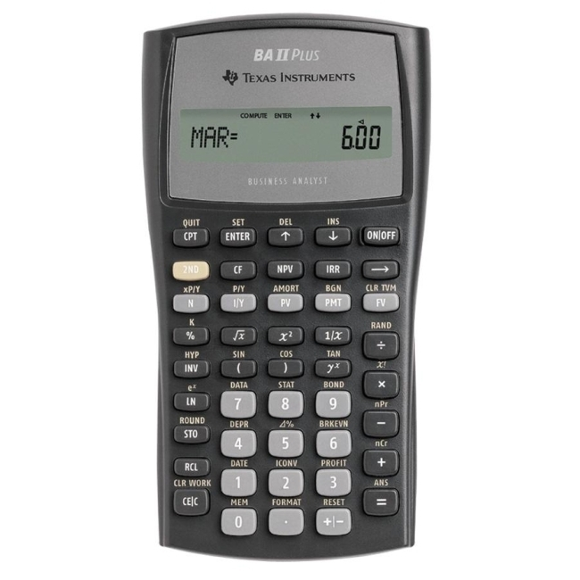
Your finance calculator can compute both parts (the annuity and the lump sum) simultaneously

Slide 25
A bond valuation example:
5 year bond
14% as the discount rate (YTM)
6% coupon interest rate
$1,000 maturity value

Slide 26
TI BA II Plus
5 years = N
-725.35
14% = Discount rate (YTM)
$60 = Payment (PMT)
$1,000 = FV
1st
PV = ?
2nd
7-26

Slide 27
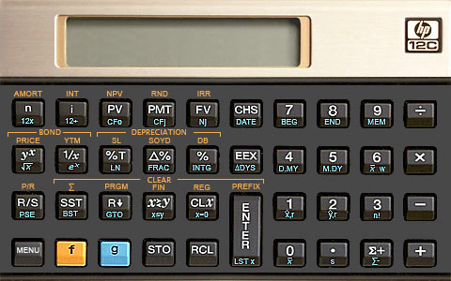
Your finance calculator can compute both parts (the annuity and the lump sum) simultaneously

Slide 28
A bond valuation example:
5 year bond
14% as the discount rate (YTM)
6% coupon interest rate
$1,000 maturity value

Slide 29
5 years = N
HP 12-C
14% = Discount rate (or YTM)
$60 = Payment (PMT)
PV = ?
$1,000 = FV
-725.35

Slide 30
Using Excel to value a bond
There is a specific formula for finding bond prices on a spreadsheet
  PRICE(Settlement,Maturity,Rate,Yld,Redemption, Frequency,Basis)
  YIELD(Settlement,Maturity,Rate,Pr,Redemption, Frequency,Basis)
  Settlement and maturity need to be actual dates
  The redemption and Pr need to be input as % of par value
Click on the Excel icon for an example:

Slide 31
Student alert!
Notice that we have two “interest numbers” in our bond problem:
1. The coupon interest rate (6% in our example) and
2. The discount rate (14% in our example) to bring future values back into the present value.

Slide 32

Student alert!
Keep it simple:
Once you have computed the annuity amount, you can throw away the “coupon interest rate”. You need the dollar amount of the annuity, not the coupon interest rate itself.

Slide 33
Chapter Outline
Bond Definition
Bond Features
Valuation of a Bond
Bond Relationships
Inflation and Interest Rates
Determinants of Bond Yields
Bond Ratings
Bond Markets

Slide 34
Bond Relationships
Key concept:
If the coupon interest rate
exactly equals the discount rate, then the bond value today will ALWAYS = the par value ($1,000)

Slide 35
Bond Relationships
Key concept:
In our example, if the discount rate was not 14% but instead 6% then the coupon interest rate would exactly equal the discount rate (6% = 6%) and the value of the bond today would be….
$1,000.00!

Slide 36
Bond Relationships
Key concept:
If the YTM is greater (>)than the coupon interest rate, then the value of the bond will be less than < $1,000.
Conversely, if the YTM is < the coupon interest rate, then the value of the bond will be > $1,000.

Slide 37
Bond Relationships
(using the previous
numerical example)
Discount Rate (YTM) | Coupon Interest Rate | Present Value of the Bond
6% | 6% | $1,000
4% | 6% | >$1,000
9% | 6% | <$1,000

Slide 38


Bond Relationships
Remember:
If the discount rate goes UP,
the present value of the bond goes DOWN.
If the discount rate goes DOWN,
the present value of the bond goes UP.

Slide 39
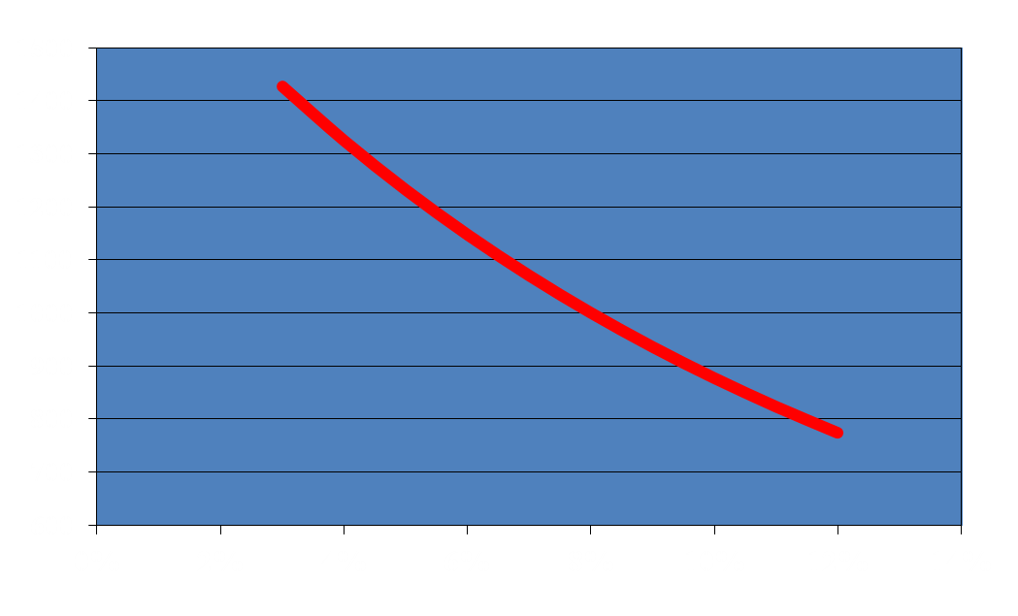
Graphical Relationship Between Price and Yield-to-maturity (YTM)
Bond Price
Yield-to-maturity (YTM)
Notes:
Bond characteristics: Coupon rate = 8% with annual coupons; Par value = $1,000; Maturity = 10 years

Slide 40
Bond Relationships
Key concept:
Are there any relationships regarding time (the length of a bond’s life) and the value of a bond?

Slide 41
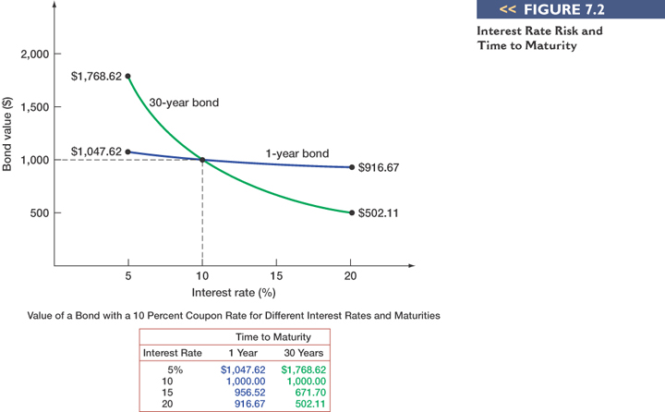
Bond Valuation

Slide 42
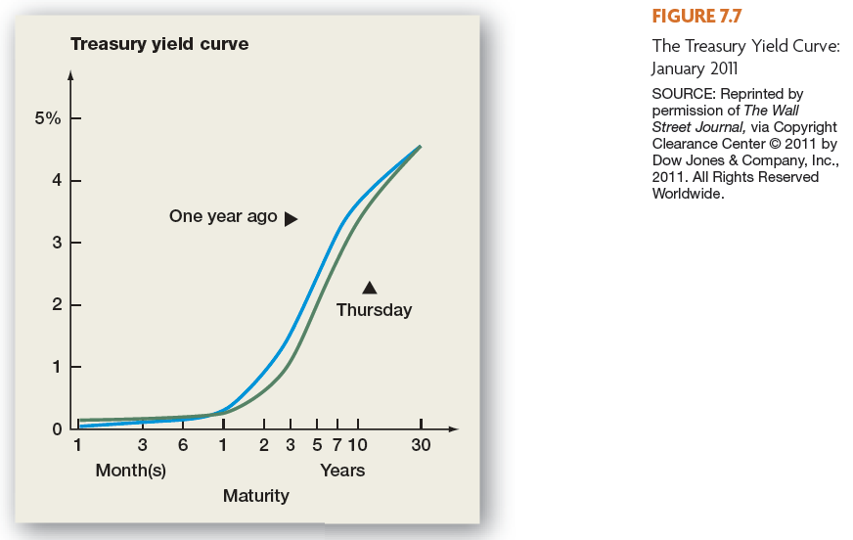
Notes:
www: Click on the web surfer to go to Bloomberg to get the current Treasury yield curve

Slide 43
Chapter Outline
Bond Definition
Bond Features
Valuation of a Bond
Bond Relationships
Inflation and Interest Rates
Determinants of Bond Yields
Bond Ratings
Bond Markets

Slide 44
The Fisher Effect
The Fisher Effect defines the relationship between real rates, nominal rates, and inflation
(1 + R) = (1 + r)(1 + h), where
  R = nominal rate
  r = real rate
  h = expected inflation rate
Approximation
  R = r + h
Notes:
The approximation works pretty well with “normal” real rates of interest and expected inflation. If the expected inflation rate is high, then there can be a substantial difference.

Slide 45
Fisher Effect Example
If we require a 10% real return and we expect inflation to be 8%, what is the nominal rate?
R = (1.1)(1.08) – 1 = .188 = 18.8%
An Approximation: R = 10% + 8% = 18%
Because the real return and expected inflation are relatively high, there is significant difference between the actual Fisher Effect and the approximation.
Notes:
Lecture Tip: In late 1997 and early 1998 there was a great deal of talk about the effects of deflation among financial pundits, due in large part to the combined effects of continuing decreases in energy prices, as well as the upheaval in Asian economies and the subsequent devaluation of several currencies. How might this affect observed yields? According to the Fisher Effect, we should observe lower nominal rates and higher real rates and that is roughly what happened. The opposite situation, however, occurred in and around 2008.

Slide 46
Chapter Outline
Bond Definition
Bond Features
Valuation of a Bond
Bond Relationships
Inflation and Interest Rates
Determinants of Bond Yields
Bond Ratings
Bond Markets

Slide 47
Term Structure of Interest Rates
The term structure is the relationship between time to maturity and yields, all else equal
(It is important to recognize that we have pulled out the effect of default risk, different coupons, etc.)

Slide 48
Term Structure of Interest Rates
Yield curve – graphical representation of the term structure
  Normal – upward-sloping; long-term yields are higher than short-term yields
  Inverted – downward-sloping; long-term yields are lower than short-term yields

Slide 49
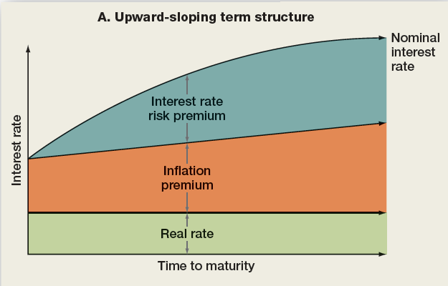
Upward-Sloping Yield Curve

Slide 50
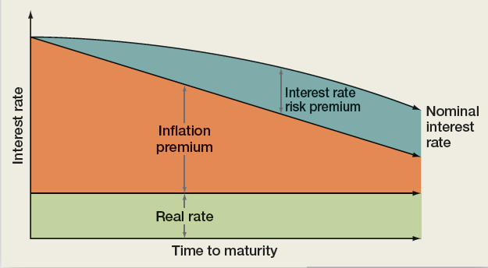
Downward-Sloping Yield Curve

Slide 51
Chapter Outline
Bond Definition
Bond Features
Valuation of a Bond
Bond Relationships
Inflation and Interest Rates
Determinants of Bond Yields
Bond Ratings
Bond Markets

Slide 52

Bond Ratings – Investment Quality
High Grade
  Moody’s Aaa and S&P AAA – capacity to pay is extremely strong
  Moody’s Aa and S&P AA – capacity to pay is very strong
Medium Grade
  Moody’s A and S&P A – capacity to pay is strong, but more susceptible to changes in circumstances
  Moody’s Baa and S&P BBB – capacity to pay is adequate, adverse conditions will have more impact on the firm’s ability to pay
Notes:
Lecture Tip: The question sometimes arises as to why a potential issuer would be willing to pay rating agencies tens of thousands of dollars in order to receive a rating, especially given the possibility that the resulting rating could be less favorable than expected. This is a good place to remind students about the pervasive nature of agency costs and point out a real-world example of their effects on firm value. You may also wish to use this issue to discuss some of the consequences of information asymmetries in financial markets.

Slide 53

Bond Ratings - Speculative
Low Grade
  Moody’s Ba and B
  S&P BB and B
  Considered possible that the capacity to pay will degenerate.
Very Low Grade
  Moody’s C (and below) and S&P C (and below)
    income bonds with no interest being paid, or
    in default with principal and interest in arrears
Notes:
It is a good exercise to ask students which bonds will have the highest yield to maturity (lowest price) all else equal.

Slide 54
Chapter Outline
Bond Definition
Bond Features
Valuation of a Bond
Bond Relationships
Inflation and Interest Rates
Determinants of Bond Yields
Bond Ratings
Bond Markets

Slide 55
Work the Web Example
Bond quotes are available online
One good site is http://www.bondsonline.com/
Click on the web surfer to go to the site
  Follow the bond search, corporate links
  Choose a company, enter it under Express Search Issue and see what you can find!

Slide 56
Terminology
Bond
Par value (face value)
Coupon rate
Coupon payment
Maturity date
Yield or Yield to Maturity (YTM)

Slide 57
Formulas
Fisher Effect: (1 + R) = (1 + r)(1 + h)
  Fisher Effect (approximation): R = r + h

Slide 58
Key Concepts and Skills
Bond definition
Computation of bond’s value
Inverse relationship between YTM and bond value
Impact of inflation on bonds
Term structure of interest rates

Slide 59

What are the most important topics of this chapter?
A bond’s value is the present value of all expected future earnings.
2. As the risk of a bond goes up, the price or value goes down.
3. The closer the bond is to maturity, the more likely the value will approach the par value.

Slide 60
Questions?

