Slide 1
CHAPTER 1
An Overview of Financial Management and the Financial Environment

Slide 2
Topics in Chapter
Read sections 1-1, 1-2, 1-3, 1-4, 1-5, 1-6a, 1-8, 1-9, 1-10, 1-11d, 1-13.
Forms of business organization
Objective of the firm: Firm value/Stockholder wealth/fundamental stock price maximization
Financial instruments, institutions, and markets
Determinants of fundamental value

Slide 3
Overview
This chapter provides a basic idea of what financial management/managerial finance/corporate finance is all about, including an overview of the financial environment (financial markets, institutions, and securities/instruments) in which corporations operate.

Slide 4
1-1 The Five-Minute MBA Why is Financial Management important to all managers?
Some common characteristics of successful companies:
Skilled people
Strong relationships
Enough funding
Financial Management/Corporate Finance provides the skills managers need to:
Evaluate any proposal or idea;
Understand how to fund value-adding ideas.

Slide 5
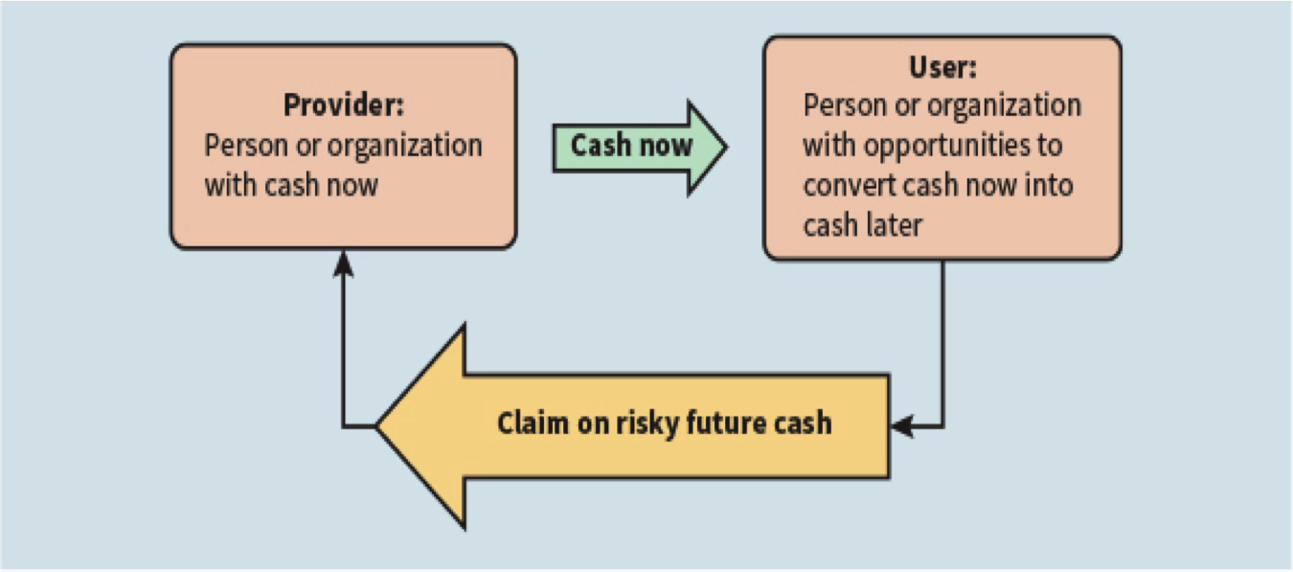
1-2 Finance from 40,000 Feet Above
Figure 1-1 Providers and Users: Cash Now versus Claims on Risky Future Cash
Financial Markets are simply ways of connecting providers with users;
Financial Analysis is a tool to evaluate risky opportunities.

Slide 6
1-3 The Corporate Life Cycle: Business Organization from Start-up to a Major Corporation
Firm: refer to all kinds of business organization.
Sole proprietorship
Partnership
Corporation
(More . . .)

Slide 7
1-3a Starting UP as a Proprietorship
Advantages:
Ease of formation
Subject to few regulations
No corporate income taxes
Disadvantages:
Limited life
Unlimited liability
Difficult to raise capital to support growth

Slide 8
1-3b More Than One Owner: A Partnership
A partnership has roughly the same advantages and disadvantages as a sole proprietorship.
Variations:
Limited Partnership (LP)
Limited Liability Partnership (LLP) and Limited Liability Company (LLC)

Slide 9
1-3c Many Owners: A corporation
A corporation is a legal entity separate from its owners and managers.
File papers of incorporation with state.
Charter
Bylaws
Variations:
Professional Corporation (PC) or Professional Association (PA)
S corporations

Slide 10
Advantages and Disadvantages of a Corporation
Advantages:
Unlimited life
Easy transfer of ownership
Limited liability
Ease of raising capital
Disadvantages:
Double taxation
Cost of set-up and report filing

Slide 11
1-3d Growing a Corporation: Going Public From a Privately-held Corporation to a Public Corporation and Growing Afterwards
Initial Public Offering (IPO) of Stock: Becoming a Public Company
Raises cash
Allows founders and pre-IPO investors to “harvest” some of their wealth
Subsequent issues of debt and equity (SEO: seasoned equity offering) in public capital markets

Slide 12
1-3e Managing a Corporation’s Value
What determines a corporation’s value?
A company’s value depends on its ability to generate expected future Free Cash Flows (FCF): cash flows available (free) for distribution to all of the company’s investors, including creditors and stockholders after the company has made all investments necessary to sustain ongoing operations.
FCF = sales revenues - operating costs - operating taxes - required investments in new operating capital

Slide 13
Three Properties of FCF:
Size of expected cash flows: bigger is better.
Timing of the cash flow stream: sooner is more valuable than later.
Risk of the cash flows: safer cash flows are worth more than uncertain cash flows.

Slide 14
FCF is not Free because:
A company must spend money to make money:
For start-ups, it comes directly from investors: creditors and stockholders;
For mature companies, some of it comes directly from new investors, and some comes indirectly from current shareholders when profit is retained and reinvested rather than paid out as dividends.
Investor’s Required Rate of Return versus Company’s Cost of Capital:
These cash providers (investors) expect a rate of return to compensate them for the timing and risk inherent in their claims on future cash flows. For creditors: interest rate on loans or bond yield; for stockholders: required return on equity consists of dividend yield and capital gains yield.
This required rate of return from an investor’s perspective is a cost (of using investor money) from a company’s point of view: hence cost of capital (expressed in percentage term).

Slide 15
What is the weighted average cost of capital (WACC)?
A company may use both debt and equity, and the cost of debt and cost of equity are different because stockholders require a higher rate of return to compensate for the higher risk (they are residual claimant): so the company’s overall cost of capital should be calculated as a weighted average of cost of debt and cost of equity: WACC.
WACC is affected by:
General level of interest rates in the economy
Investors’ overall attitude toward risk
Risk of the firm’s operations (business risk)
Firm’s capital structure: debt/equity mix (financial risk)

Slide 16
What determines a firm’s fundamental, or intrinsic, value? The Relationship between value, FCF, and cost of capital
Intrinsic value is the sum of all the expected future free cash flows when converted (discounted at the cost of capital) into today’s dollars:
FCF₁
FCF₂
FCF∞
Value = + + … +
(1 + WACC)¹
(1 + WACC)²
(1 + WACC)∞
See “big picture” diagram on next slide.
(More . . .)

Slide 17
Determinants of Intrinsic Value: The Big Picture
Sales revenues
−
Operating costs and taxes
−
Required investments in operating capital
Free cash flow
(FCF)
=
FCF₁
FCF₂
...
FCF∞
Value = + + +
(1 + WACC)¹
(1 + WACC)²
(1 + WACC)∞
Weighted average
cost of capital
(WACC)
Market interest rates
Cost of debt
Cost of equity
Firm’s debt/equity mix
Market risk aversion
Firm’s business risk

Slide 18
Intrinsic Value versus Market Price
If markets are efficient and investors are rational (investors’ expectations correctly incorporate all relevant information): market price should be equal to intrinsic/fundamental value.
A large body of evidence in psychology shows that people often behave irrationally but in predictable ways. Behavioral Finance suggests that market price may deviate (overvalue or undervalue) from intrinsic value; but eventually it would revert to the fundamental value.

Slide 19
1-4 Governing a Corporation
Agency problem: managers may act in their own interests and not on behalf of owners (stockholders).
Corporate governance is the set of rules that control a company’s behavior towards its directors, managers, employees, shareholders, creditors, customers, competitors, and community.
Corporate governance can help control agency problems.

Slide 20
1-4a The Primary Objective of a Corporation: Maximizing Stockholder Wealth
The primary objective should be shareholder wealth maximization, which translates to maximizing the current value per share of the existing stock.
Should firms behave ethically? YES!
Do firms have any responsibilities to society at large? YES!

Slide 21
Important Caveat: it’s NOT profit maximization
Stockholder wealth/intrinsic value/fundamental price
versus
(Accounting) profit/earnings/net income:
Wealth/Value is measured at present (sum of all the future discounted FCFs), while profits are a stream/flow (which year to maximize?).
The earnings stream does not coincide with the free cash flows: timing of cash flows matters due to time value of money (Chapter 4). (Earnings and FCFs are positively correlated in the long run.)
Profits don’t reflect risk, while the valuation formula incorporates risk in the denominator WACC: ceteris paribus, risky assets would be worth less.

Slide 22
1-4b Intrinsic Stock Value Maximization and Social Welfare
Most individuals have a stake in the stock market directly or indirectly.
Consumers benefit in a reasonably competitive economy.
Employees benefit in general.

Slide 23
1-4c Ethics and Intrinsic Stock Value Maximization
How does a lack of commitment to ethical behavior affect stock prices?
Latest Examples: Wells Fargo, Mylan (EpiPen)
With respect to financial misdeeds, the Sarbanes-Oxley Act of 2002 and the Dodd-Frank Wall Street Reform and Consumer Protection Act of 2010 strengthened protection for whistleblowers who report financial wrongdoing.

Slide 24
1-5 An overview of Financial Markets 1-5a The Net Providers and Users of Capital
Who are the providers (savers) and users (borrowers) of capital?
Individuals: Net savers
Non-financial corporations: Net users (borrowers)
Governments: U.S. governments are net borrowers, some foreign governments are net savers
Financial corporations: Slightly net borrowers, but almost breakeven

Slide 25
1-5b Getting Cash from Providers to Users: The Capital Allocation Process
1. Direct Transfer
Business’s Securities
Business
Savers
Dollars
2. Through Investment Bank
Business
Business’s Securities
Investment Bank
Business’s Securities
Savers
Dollars
Dollars
3. Through Financial Intermediary
Intermediary’s
Securities
Business
Business’s Securities
Financial Intermediary
Savers
Dollars
Dollars

Slide 26
Transfer of Capital from Savers to Borrowers
Direct transfer
Example: A privately held company sells stock directly to a new shareholder.
Through an investment banking house
Example: In an IPO, seasoned equity offering, or debt placement, company sells security to investment banking house, which then sells the same security to investor.
Through a financial intermediary
Example: An individual deposits money in bank and gets certificate of deposit, bank makes commercial loan to a company (bank gets note from company).

Slide 27
1-6 Claims on Future Cash Flows: Types of Financial Securities 1-6a Debt, Equity, or Derivatives
 | Debt | Equity | Derivatives
Short-term | T-Bills Negotiable CDs Commercial paper Money market mutual funds |  | Options Futures Forward contracts
Long-term | T-Bonds Mortgages Municipal bonds Corporate bonds | Preferred stocks (Hybrid) Common stocks | Swaps
Short-term debt instruments are called money-market instruments; while long-term debt instruments and equity are called capital market instruments.

Slide 28
Typical Rates of Return: Table 1-1 Summary of Major Financial Instruments
Instrument | Annualized Rate (on1/23/15)
U.S. T-bills | 0.02%
Banker’s acceptances | 0.23
Commercial paper | 0.12
Negotiable CDs | 0.21
Eurodollar deposits | 0.37
Commercial loans:
Tied to prime rate | 3.25 +
or LIBOR | 0.35 +
(More . . .)

Slide 29
Typical Rates (Continued)
Instrument | Annualized Rate (on 1/23/15)
U.S. T-notes and T-bonds | 1.81%
Mortgages | 3.63
Municipal bonds | 3.36
Corporate bonds | 4.41
Preferred stocks | 6% to 9%
Common stocks | 9% to 15%

Slide 30
1-8 The Functions of Financial Institutions
According to the capital allocation process in 1-5b, financial institutions can be classified into two broad categories:
Investment banks and brokerage services
Financial intermediaries:
Deposit-taking institutions: commercial banks, S&Ls, credit unions
Investment funds: mutual funds, ETFs, hedge funds, private equity funds
Life insurance companies and pension funds
Financial regulation (?)
One result of deregulation was the creation of huge financial services corporations/bank holding companies: they offer a wide range of financial services including commercial banking, investment banking, asset management, and insurance etc.

Slide 31
1-9 Financial Markets
Financial Markets serve to connect providers of funds with users for the purpose of exchanging cash now for claims on future cash: Primary Markets
In addition, they provide a means for trading securities after they have been issued: Secondary Markets

Slide 32
1-9a Types of Financial Markets
Physical asset markets vs. financial asset markets
Spot markets versus futures markets
Money markets versus capital markets
Mortgage markets versus consumer credit markets
Private markets versus public markets
World, National, Regional, and Local Markets

Slide 33
Primary vs. Secondary Markets
Primary Markets:
New issue (IPO or SEO or Bond Issuance)
Key factor: issuer (corporation) receives the proceeds from the sale.
Secondary Markets:
Existing securities are traded among investors.
Issuing firm doesn’t receive proceeds and is not directly involved.

Slide 34
1-9b Why are Secondary Markets Important?
Primary Market Transactions:
raise capital for the corporation;
Secondary Market Transactions: establish value/price and provide liquidity to investors and entrepreneurs.

Slide 35
1-9c Trading Procedures in the Secondary Markets
By “location”
Physical location exchanges
Electronic networks
By the way that orders from buyers and sellers are matched
Open outcry auctions
Dealer markets
Automated Trading Platforms

Slide 36
Physical Location vs. Computer/Telephone Network
Physical location exchanges: e.g., NYSE, London Metal Exchange
Computer/telephone (Electronic) Network: e.g., Nasdaq, Treasury bond markets, foreign exchange markets

Slide 37
Matching Orders: Auctions, Dealers, and Automated Trading Platforms
How orders are matched are behind scenes: retail investors usually don’t perceive any differences in trading NYSE- or NASDAQ-listed stocks.
Types of Orders: instructions on how a transaction is to be completed
Market Order– Transact as quickly as possible at current price
Limit Order– Transact only if specific situation occurs. For example, buy if price drops to $50 or below during the next two hours.

Slide 38
Auction Markets
Participants have a seat on the exchange, meet face-to-face, and place orders for themselves or for their clients; e.g. NYSE

Slide 39
Dealer Markets
“Dealers” keep an inventory of the stock (or other financial asset) and place bid and ask “advertisements,” which are prices at which they are willing to buy and sell.
Often many dealers for each stock
Computerized quotation system keeps track of bid and ask prices, but does not automatically match buyers and sellers.
Examples: NASDAQ

Slide 40
Automated Trading Platforms
Computerized system matches orders from buyers and sellers and automatically executes transaction.
Automated trading systems are rapidly replacing face-to-face trading in the secondary stock markets.

Slide 41
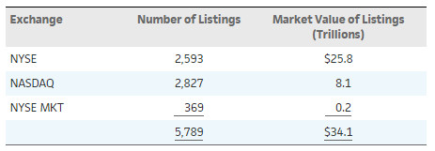
1-10 Overview of the U.S. Stock Markets
Although listings are still concentrated at the NYSE and NASDAQ, a company’s shares can and do trade at many different venues.
In addition, very little stock trading is conducted face-to-face, but is instead executed with automated trading platforms.
Table 1-2 Stock Exchange Listings and Total Market Value (2015)

Slide 42
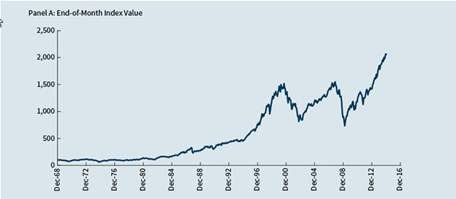
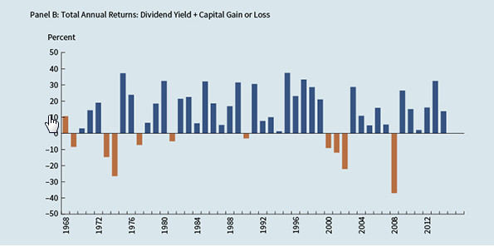
1-11d Stock Market Returns
Figure 1-5 S&P 500 Stock Index Performance

Slide 43
1-13 The Big Picture
A firm’s primary goal is to maximize the company’s intrinsic value:
Intrinsic value is the present value of the firm’s expected free cash flows, discounted at the weighted average cost of capital.
Thus there are two approaches for increasing intrinsic value: improve FCF or reduce WACC.

Slide 44
Determinants of Intrinsic Value: The Big Picture
Sales revenues
−
Operating costs and taxes
−
Required investments in operating capital
Free cash flow
(FCF)
=
FCF₁
FCF₂
...
FCF∞
Value = + + +
(1 + WACC)¹
(1 + WACC)²
(1 + WACC)∞
Weighted average
cost of capital
(WACC)
Market interest rates
Cost of debt
Cost of equity
Firm’s debt/equity mix
Market risk aversion
Firm’s business risk

Slide 45
Homework Problems:
Questions on P54:
1(a-i), 2, 3, 4, 5, 6, 7, 8, 10

