Slide 1
Chapter 5-2 Compound Interest, Future, and Present Value

Slide 2
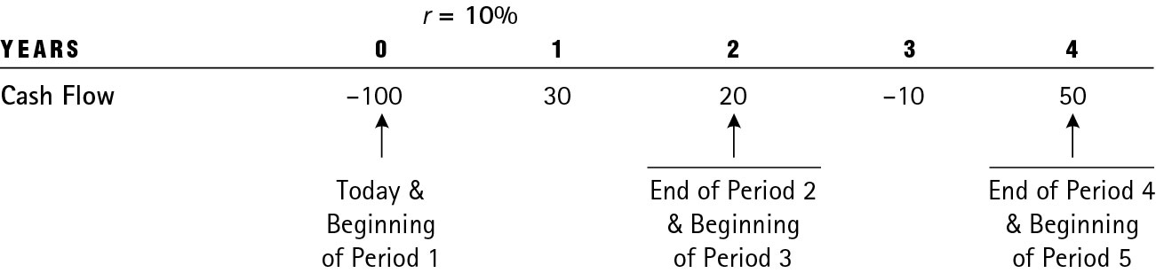
Using Timelines to Visualize Cash Flows
Timeline of cash flows

Slide 3
Compound Interest (1 of 2)
Compounding is when interest paid on an investment during the first period is added to the principal; then, during the second period, interest is earned on the new sum (that includes the principal and interest earned so far).

Slide 4
Compound Interest (2 of 2)
Example: Compute compound interest on $100 invested at 6% for three years with annual compounding.
First year interest is $6.00; principal now is $106.00.
Second year interest is $6.36; principal now is $112.36.
Third year interest is $6.74; principal now is $119.10.
Total interest earned: $19.10

Slide 5
Future Value
Future value is the amount a sum will grow to in a certain number of years when compounded at a specific rate.
FVN = the future of the investment at the end of “n” years
r = the annual interest (or discount) rate
n = number of years
PV = the present value, or original amount invested at the beginning of the first year

Slide 6
Future Value Example
Example: What will be the FV of $100 in 2 years at interest rate of 6%?

Slide 7
How to Increase the Future Value?
Future value can be increased by
Increasing number of years of compounding (N)
Increasing the interest or discount rate (r)
Increasing the original investment (PV)
See example on next slide.

Slide 8
Changing R, N, and PV
a. You deposit $500 in bank for 2 years. What is the FV at 2%? What is the FV if you change interest rate to 6%?
b. Continue the same example but change time to 10 years. What is the FV now?
c. Continue the same example but change contribution to $1,500. What is the FV now?

Slide 9
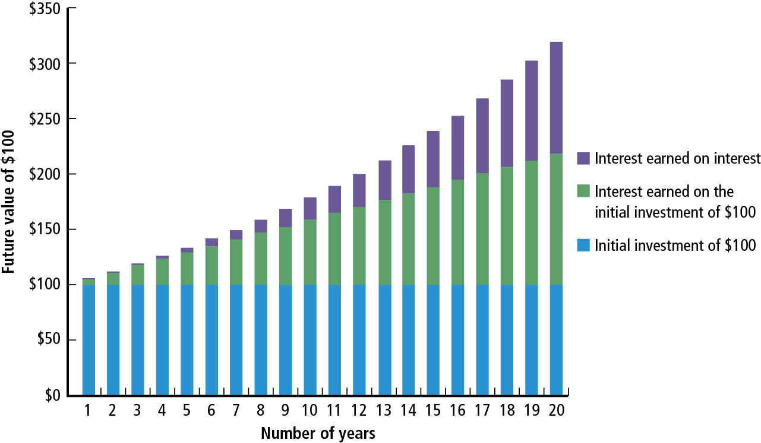
Figure 5.1 $100 Compounded at 6 Percent over 20 Years

Slide 10
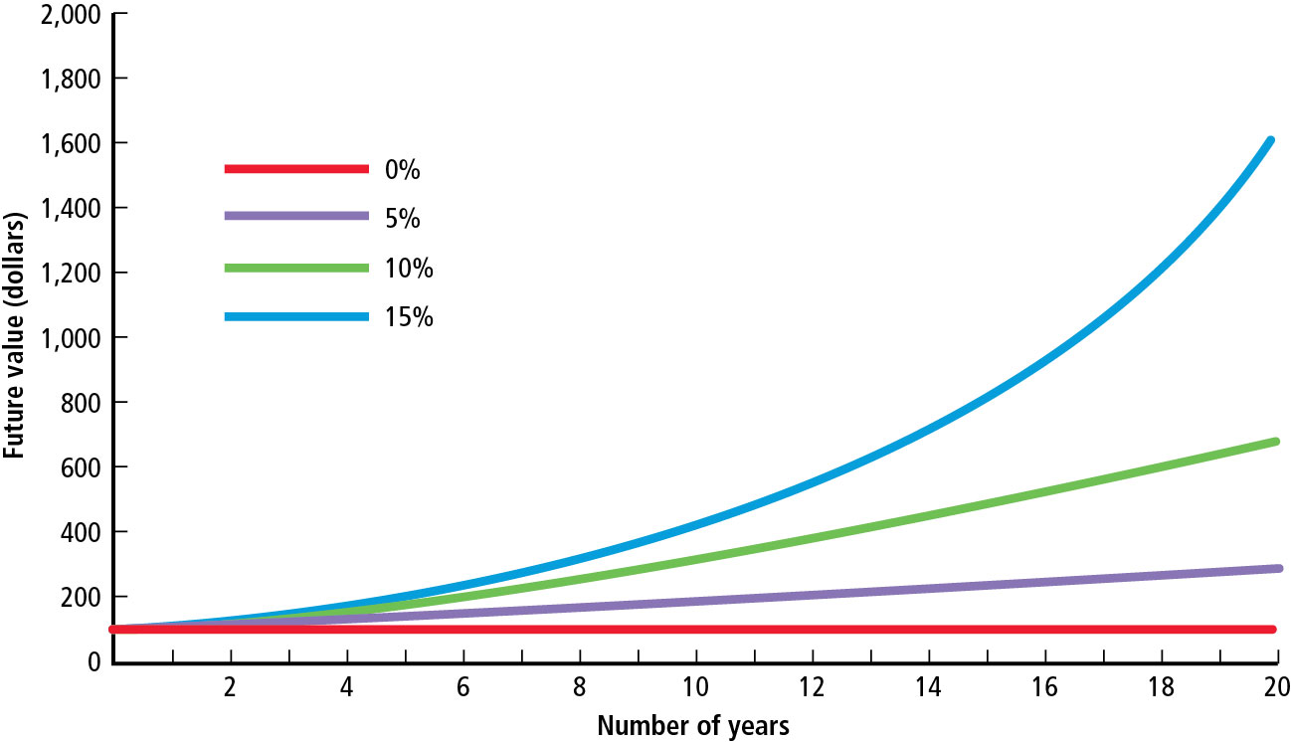
Figure 5.2 The Future of $100 Initially Deposited and Compounded at 0, 5, 10, and 15 Percent (1 of 2)

Slide 11
Figure 5.2 The Future of $100 Initially Deposited and Compounded at 0, 5, 10, and 15 Percent (2 of 2)
Figure 5.2 illustrates that we can increase the FV by
Increasing the number of years for which money is invested
Investing at a higher interest rate

Slide 12
Computing Future Values Using Calculator or Excel
Review discussion in the textbook.
Excel Function for FV: = FV(rate, nper, pmt, pv)

Slide 13
Present Value (1 of 2)
Present value reflects the current value of a future payment or receipt.

Slide 14
Present Value (2 of 2)
FVn = the future value of the investment at the end of n years
n = number of years until payment is received
r = the interest rate
PV = the present value of the future sum of money

Slide 15
Present Value Example
What will be the present value of $500 to be received 10 years from today if the discount rate is 6%?

Slide 16
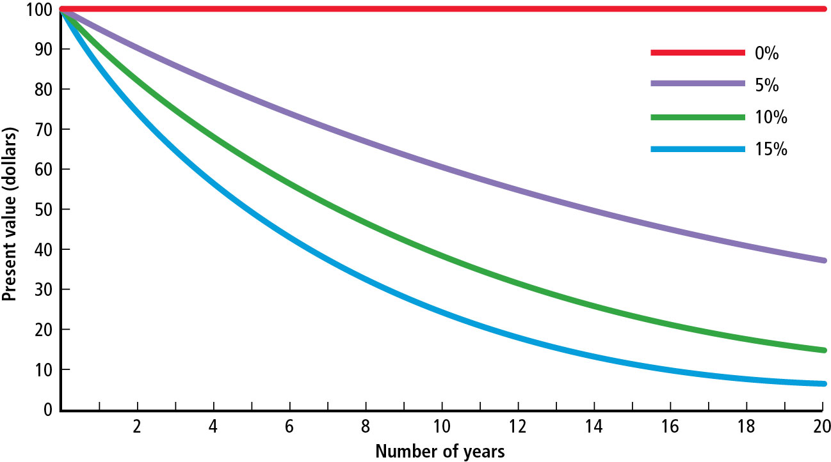
Figure 5.3 The Present Value of $100 to Be Received at a Future Date and Discounted Back to the Present at 0, 5, 10, and 15 Percent (1 of 2)

Slide 17
Figure 5.3 The Present Value of $100 to Be Received at a Future Date and Discounted Back to the Present at 0, 5, 10, and 15 Percent (2 of 2)
Figure 5.3 illustrates that PV is lower if
Time period is longer, or
Interest rate is higher.

Slide 18
Using Excel
Excel Function for PV: = PV(rate,nper,pmt,fv)

Slide 19
Annuities

Slide 20
Annuities
An annuity is a series of equal dollar payments for a specified number of years.
Ordinary annuity payments occur at the end of each period.

Slide 21
FV of Annuity
Compound Annuity
Depositing or investing an equal sum of money at the end of each year for a certain number of years and allowing it to grow

Slide 22
FV Annuity Example
What will be the FV of a 5-year, $500 annuity compounded at 6%?

Slide 23
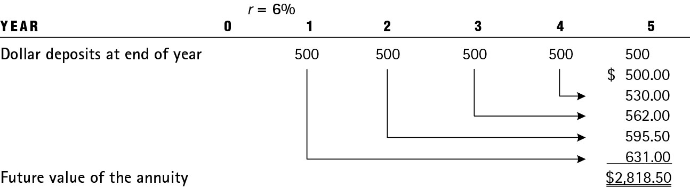
Table 5.1 Growth of a 5-Year, $500 Annuity Compounded at 6 Percent

Slide 24
FV of an Annuity – Using the Mathematical Formulas (1 of 2)
FV_{n} = the future of an annuity at the end of the nth year
PMT = the annuity payment deposited or received at the end of each year
r = the annual interest (or discount) rate
n = the number of years

Slide 25
FV of an Annuity – Using the Mathematical Formulas (2 of 2)
What will $500 deposited in the bank every year for 5 years at 6% be worth?
​

Slide 26
FV of Annuity: Changing PMT, N, and r (1 of 2)
What will $5,000 deposited annually for 50 years be worth at 7%?
FV = $2,032,644
Contribution = $250,000 (= 5000×50)
Change PMT = $6,000 for 50 years at 7%
FV = $2,439,173
Contribution = $300,000 (= 6000×50)

Slide 27
FV of Annuity: Changing PMT, N, and r (2 of 2)
3. Change time = 60 years, $6,000 at 7%
FV = $4,881,122
Contribution = $360,000 (= 6000×60)
4. Change r = 9%, 60 years, $6,000
FV = $11,668,753
Contribution = $360,000 (= 6000×60)

Slide 28
Present Value of an Annuity
Pensions, insurance obligations, and interest owed on bonds are all annuities. To compare these three types of investments we need to know the present value (PV) of each.

Slide 29
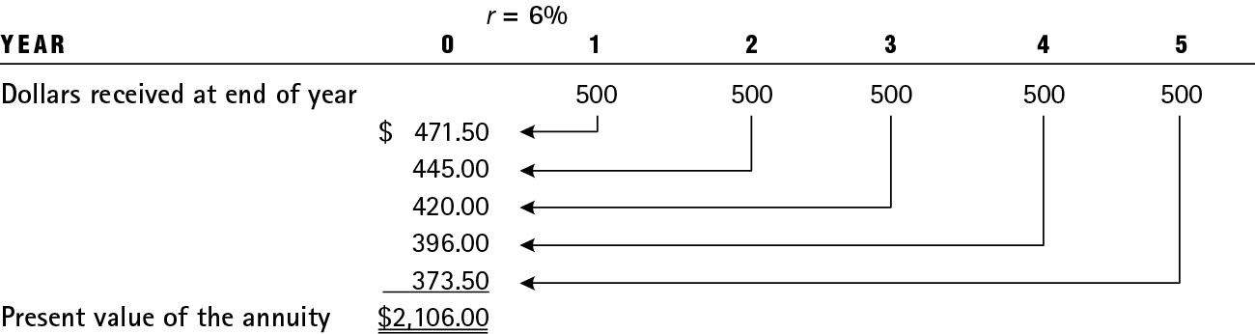
Table 5.2 Illustration of a 5-Year, $500 Annuity Discounted to the Present at 6 Percent

Slide 30
PV of Annuity – Using the Mathematical Formulas

Slide 31
Making Interest Rates Comparable
We cannot compare rates with different compounding periods. For example, 5% compounded annually is not the same as 5% percent compounded quarterly.
To make the rates comparable, we compute the annual percentage rate (APR) and the effective annual rate (EAR).

Slide 32
Quoted Rate versus Effective Rate (1 of 2)

Slide 33
Quoted Rate versus Effective Rate (2 of 2)
Quoted rate could be very different from the effective rate if compounding is not done annually.
If the APR of a quoted loan is 7.85%, but it is compounded quarterly, the EAR is actually 8.084%.

Slide 34
Table 5.4 The Value of $100 Compounded at Various Intervals (1 of 2)
For 1 Year at r Percent
r = | 2% | 5% | 10% | 15%
Compounded annually | $102.00 | $105.00 | $110.00 | $115.00
Compounded semiannually | 102.01 | 105.06 | 110.25 | 115.56
Compounded quarterly | 102.02 | 105.09 | 110.38 | 115.87
Compounded monthly | 102.02 | 105.12 | 110.47 | 116.08
Compounded weekly (52) | 102.02 | 105.12 | 110.51 | 116.16
Compounded daily (365) | 102.02 | 105.13 | 110.52 | 116.18

Slide 35
Questions? Thoughts?

